Slide 1
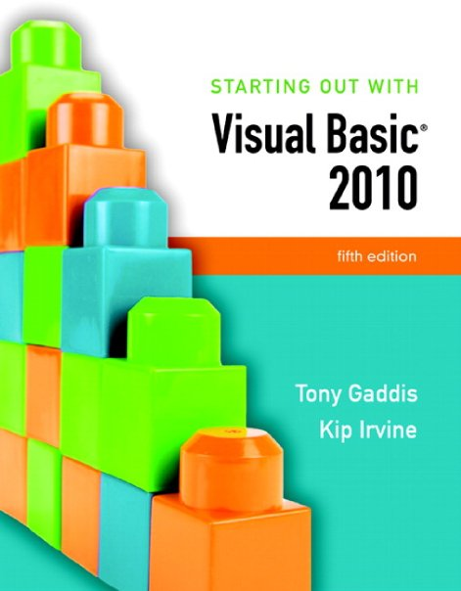

Slide 2
Chapter 3
Variables and Calculations

Slide 3
Gathering Text Input
Section 3.1
In this section, we use the TextBox control to gather input the user
has typed on the keyboard. We also alter a form’s tab order and assign
keyboard access keys to controls.

Slide 4
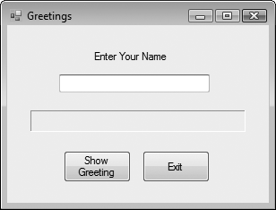
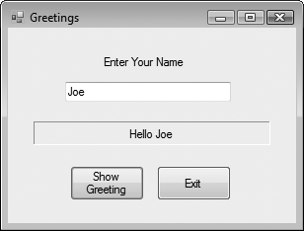
The TextBox Control
A text box is a rectangular area on a form that accepts input from a keyboard
Tutorial 3-1 provides an example in the use of a text box

Slide 5
Using the Text Property in Code
The TextBox control’s Text property can be accessed in code the same way you access other properties
For Example:
  The contents of the Text property can be assigned into a Label control’s Text property:
  lblInfo.Text = txtInput.Text
  The contents of the Text property can be displayed in a message box
  MessageBox.Show(txtInput.Text)

Slide 6
Clearing a Text Box
Can be done with an assignment statement:
  txtInput.Text = String.Empty
  assigning the predefined constant String.Empty replaces whatever text was in txtInput with an empty string
Can also be done with a method:
  txtInput.Clear()
  Clear is a Method, not a Property
  Methods are actions – as in clearing the text
  Uses the form Object.Method

Slide 7
String Concatenation
Assume the user has entered their name into the TextBox txtName
Label lblGreeting can say, “Hello” to any name found in the TextBox
  lblGreeting.Text = "Hello " & txtName.Text
  Appends user name in txtName.Text to “Hello ” and stores result in text property of lblGreeting

Slide 8
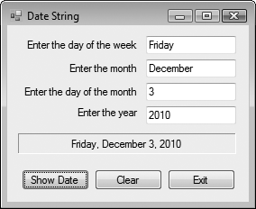
String Concatenation
Tutorial 3-2 provides another example of how to concatenate strings from text boxes
txtDayOfWeek
txtMonth
txtDayOfMonth
txtYear
lblDateString
btnExit
btnClear
btnShowDate

Slide 9
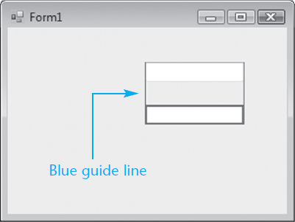
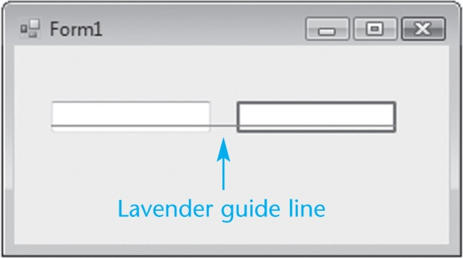
Aligning Controls in Design Mode
When dragging a control to a form, it can be aligned with a control already on the form
  Blue guide lines appear for vertical alignment
  Lavender guide lines for horizontal alignment

Slide 10
The Focus Method
For a control to have the focus means that it is ready to receive the user's input
In a running form, one and only one of the controls on the form may have the focus
Only a control capable of receiving some sort of input may have the focus
The focus can be set to a control in code using the Focus method:
txtUserName.Focus()

Slide 11
The Focus Method
You can tell which control has focus by its characteristics:
  When a TextBox has focus, it will have a blinking cursor or its text will be highlighted
  When a button, radio button, or a check box has focus, you’ll see a thin dotted line around the control
Tutorial 3-3 shows an example of the Focus method

Slide 12
Controlling a Form’s Tab Order with the TabIndex Property
Tab key steps focus from one control to the next
This order is set by the TabIndex property
The Tab key causes the focus to jump to the control with the next highest TabIndex value
The TabIndex property is best changed with the Tab Order option from the View menu
  Displays the form in tab order selection mode
  Set a new tab order by clicking the controls in the order you want
  This sets the numeric TabIndex value

Slide 13
Assigning Keyboard Access Keys to Buttons
Say your form had a button with the text “Exit" on it
You can allow the user to activate the button using Alt-X instead of a mouse click
Just change the button text property to “E&xit"
The character following the '&' (x in this case) is designated as an access key
Be careful not to use the same access key for two different buttons

Slide 14
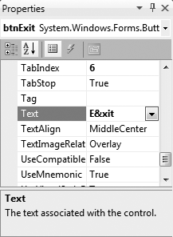
'&' Has Special Meaning in a Button
Note that the '&' in “E&xit" does not display in the button control on the form
It simply establishes the Alt Key access
In order to actually display an '&' on a button, it must be entered as "&&“
  Button text Save & Exit is entered as Save && Exit

Slide 15
Setting the Accept Button
The accept button is a button that is implicitly activated if the user hits the Enter Key
The AcceptButton Property designates which button on the form will behave in this manner
The button clicked most frequently on a form is usually assigned as the accept button

Slide 16
Setting the Cancel Button
The cancel button is a button that is implicitly activated if the user hits the Escape Key
The CancelButton Property designates which button on the form will behave in this manner
Any exit or cancel button on a form is a candidate to become the cancel button
Tutorial 3-5 provides examples of setting access keys, accept, and cancel buttons

Slide 17
Variables and Data Types
Section 3.2
Variables hold data that may be manipulated, used to manipulate
other data, or remembered for later use.

Slide 18
Why Have Variables?
A variable is a storage location in the computer’s memory, used for holding information while the program is running
The information that is stored in a variable may change, hence the name “variable”

Slide 19
What Can You Do With Variables?
Copy and store values entered by the user, so they may be manipulated
Perform arithmetic on values
Test values to determine that they meet some criterion
Temporarily hold and manipulate the value of a control property
Remember information for later use in the program

Slide 20
How to Think About Variables
You the programmer make up a name for the variable
Visual Basic associates that name with a location in the computer's RAM
The value currently associated with the variable is stored in that memory location

Slide 21
Declaring Variables
A variable declaration is a statement that creates a variable in memory
The syntax is:
Dim VariableName As DataType
  Dim (short for Dimension) is a keyword
  VariableName is the programmer designated name
  As is a keyword
  DataType is one of many possible keywords for the type of value the variable will contain
Here is an example of a variable declaration:
Dim intLength as Integer

Slide 22
Declaring Multiple Variables
Several variables may be declared in one statement if they all hold the same type of value
Dim intLength, intWidth, intHeight as Integer
Or this can be done in 3 separate statements
Dim intLength as Integer
Dim intWidth as Integer
Dim intHeight as Integer

Slide 23
Variable Naming Rules
The first character of a variable name must be a letter or an underscore
Subsequent characters may be a letter, underscore, or digit
  Thus variable names cannot contain spaces or periods (or many other kinds of characters)
Visual Basic keywords cannot be used as variable names

Slide 24
Variable Naming Conventions
Naming conventions are a guideline to help improve readability but not required syntax
A variable name should describe its use
Each data type has a recommended prefix, in lower case, that begins the variable name
The 1st letter of each subsequent word in the variable name should be capitalized
  intHoursWorked - an integer variable
  strLastName - a string (or text) variable

Slide 25
Setting the Value of a Variable
An assignment statement is used to set the value of a variable, as in:
  Assign the value 112 to the variable length
  length = 112
  Assign the string literal “Good Morning “ followed by the contents of the text box txtName to the variable greeting
  greeting = "Good Morning " & txtName.Text
An assignment changes only the left operand
The right operand remains unchanged

Slide 26
Visual Basic Data Types
Integer types
  Byte
  Short
  Integer
  Long
Floating-Point types
  Single
  Double
  Decimal
Other data types
  Boolean
  Char
  String
  Date

Slide 27
Integer Data Types
For values that will always be a whole number
Usually name a variable starting with a 3 or 4 letter prefix indicating the variable’s type
Data Type | Naming Prefix | Description
Byte | byt | Unsigned integer from 0 to 255
Short | shrt | Signed integer from -32,768 to 32,767
Integer | int | Signed integer from -2,147,483,648 to 2,147,483,647
Long | lng | Signed integer from -9,223,372,036,854,775,808 to 9,223,372,036,854,775,807

Slide 28
Floating-Point Data Types
For values that may have fractional parts
Single used most frequently
Double sometimes used in scientific calculations
Decimal often used in financial calculations
Data Type | Naming Prefix | Description
Single | sng | As large as 10³⁸ plus or minus, 7 decimal positions
Double | dbl | As large as 10³⁰⁸ plus or minus,15 decimal positions
Decimal | dec | As large as 10²⁹ plus or minus, 29 decimal positions

Slide 29
Other Common Data Types
Boolean – variable naming prefix is bln
  Holds 2 possible values, True or False
Char – variable naming prefix is chr
  Holds a single character
  Allows for characters from other languages
String – variable naming prefix is str
  Holds a sequence of up to 2 billion characters
Date – variable naming prefix is dat or dtm
  Can hold date and/or time information

Slide 30
The String Data Type
A string literal is enclosed in quotation marks
  The following code assigns the name Jose Gonzales to the variable strName
Dim strName as string
strName = "Jose Gonzales"
An empty string literal can be coded as:
  Two consecutive quotation marks
strName = ""
  Or by the special identifier String.Empty
strName = String.Empty

Slide 31
The Date Data Type
Date data type variables can hold the date and time or both
  You can assign a date literal to a Date variable, as shown here:
Dim dtmBirth As Date
dtmBirth = #5/1/2010#
A date literal is enclosed within # symbols
  All of the following Date literals are valid:
  #12/10/2010#
#8:45:00 PM#
#10/20/2010 6:30:00 AM#

Slide 32
Assigning Text to a Variable
Tutorial 3-6 provides an example of how the contents of text boxes are assigned to a string variable
' Declare a string variable to hold the full name.
Dim strFullName As String
' Combine the first and last names
' and copy the result to lblFullName
strFullName = txtFirstName.Text & " " & txtLastName.Text
lblFullName.Text = strFullName

Slide 33
Declaring Variables with IntelliSense
As you enter your program, VB often aids you by offering a list of choices that could be used at that point
After typing "As" in a variable declaration, VB will offer an alphabetical list of all possible data types
  Type the first few letters of the data type name
  IntelliSense box will highlight the matching type
  Press the Tab key to select highlighted choice
Or just complete typing the entire data type name

Slide 34
Default Values and Initialization
When a variable is first created in memory, it is assigned a default value
  numeric types are given a value of zero
  Boolean types are given a value of False
  strings are given a value of Nothing
  dates default to 12:00:00 AM January 1,1
Good practice to initialize string variables
  Dim strName as String = String.Empty
  String with value Nothing causes error if used

Slide 35
Initialization of Variables
Can provide a starting or initialization value for any type of variable in a Dim statement
Usually want to set an initial value unless assigning a value prior to using the variable
Just append = value to the Dim statement where value is the literal to be assigned to the variable
Dim intMonthsPerYear As Integer = 12

Slide 36
Scope and Local Variables
Scope refers to the part of the program where:
  A variable is visible and
  May be accessed by program code
Variables declared within a procedure are called local variables and observe these characteristics
  Scope begins where variable is declared
  Extends to end of procedure where declared
  Variable is not visible outside the procedure
A variable cannot be declared twice in the same procedure

Slide 37
Performing Calculations
Section 3.3
Visual Basic has powerful arithmetic operators that perform calculations
with numeric variables and literals.

Slide 38
Common Arithmetic Operators
Visual Basic provides operators for the common arithmetic operations:
+ Addition
- Subtraction
* Multiplication
/ Division
^ Exponentiation

Slide 39
Common Arithmetic Operators
Addition
dblTotal = dblPrice + dblTax
Subtraction
dblNetPrice = dblPrice – dblDiscount
Multiplication
intArea = intLength * intWidth
Division
dblAverage = intTotal / intItems
Exponentiation
dblCube = dblSide ^ 3

Slide 40
Special Integer Division Operator
The backslash (\) is used as an integer division operator
Divides one integer by another
The result is always an integer, created by discarding any remainder from the division
If calculating the number of hours in a given number of minutes
intHours = intMinutes \ 60
  With intMinutes equal to 190, this calculation will result in the value 3 assigned to intHours

Slide 41
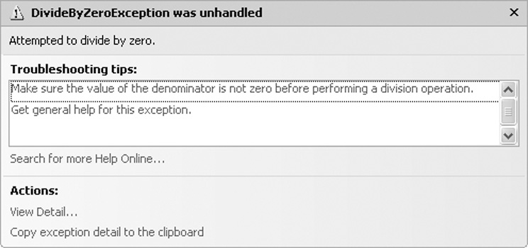
Modulus (MOD) Operator
This operator can be used in place of the backslash operator to give the remainder of a division operation
intRemainder = 17 MOD 3 ' result is 2
dblRemainder = 17.5 MOD 3 ' result is 2.5
Use of the \ or MOD
operator to perform integer
division by zero causes a
DivideByZeroException
runtime error

Slide 42
Retrieving the Current Date/Time
A series of keywords yields the current date, current time, or both
Variables datCurrent, datCurrTime, and datCurrDate must be declared as Date data types
Description | Keyword | Example
Date & Time | Now | dtmCurrent=Now
Time only | TimeOfDay | dtmCurrTime=TimeOfDay
Date only | Today | dtmCurrDate=Today

Slide 43
Combined Assignment Operators
Often need to change the value in a variable and assign the result back to that variable
  For example: intValue = intValue – 5
  Subtracts 5 from the value stored in intValue
Other examples:
  x = x + 4 Adds 4 to x
  x = x – 3 Subtracts 3 from x
  x = x * 10 Multiplies x by 10
VB provides for this common need with combined assignment operators

Slide 44
Combined Assignment Operators
These special assignment operators provide an easy means to perform these common operations:
Operator Usage Equivalent to Effect
+= x += 2 x = x + 2 Add to
-= x -= 5 x = x – 5 Subtract from
*= x *= 10 x = x * 10 Multiply by
/= x /= y x = x / y Divide by
\= x \= y x = x \ y Int Divide by
&= name &= last name = name & last Concatenate

Slide 45
Arithmetic Operator Precedence
Operator precedence tells us the order in which operations are performed
From highest to lowest precedence:
  Exponentiation (^)
  Multiplicative (* and /)
  Integer Division (\)
  Modulus (MOD)
  Additive (+ and -)
Where precedence is the same, operations occur from left to right

Slide 46
Operator Precedence Examples
The result is very different when the divide by 2 operation is moved from the end of the calculation to the middle.
  6 * 2 ^ 3 + 4 / 2
  6 * 8 + 4 / 2
  48 + 4 / 2
  48 + 2
  50
  6 / 2 * 2 ^ 3 + 4
  6 / 2 * 8 + 4
  3 * 8 + 4
  24 + 4
  28

Slide 47
Grouping with Parentheses
Parentheses () can be used to force selected parts of an expression to be evaluated before others
  Assume we’re computing the average of 3 numbers
  dblAvg = int1 + int2 + int3 / 3 ' incorrect
  int3 / 3 is evaluated first
  That result is added to int1 and int2
Use parentheses to control order of operations
  dblAvg = (int1 + int2 + int3) / 3 ' correct
  int1 + int2 + int3 is evaulated first
  That result is divided by 3
When in doubt, use parentheses!

Slide 48
Converting Mathematical
Expressions to Programming Statements
In algebra, the mathematical expression 2xy describes the value 2 times x times y.
Visual Basic requires an operator for any mathematical operation.
Mathematical Expression | Operation | Visual Basic Equivalent
6B | 6 times B | 6 * B
(3)(12) | 3 times 12 | 3 * 12
4xy | 4 times x times y | 4 * x * y

Slide 49
Mixing Different Data Types
Section 3.4
When you assign a value of one data type to a variable of another data type, Visual Basic attempts to convert the value being assigned to the data type of the receiving variable.

Slide 50
Implicit Type Conversions
A value of one data type can be assigned to a variable of a different type
  An implicit type conversion is an attempt to convert to the receiving variable’s data type
A widening conversion suffers no loss of data
  Converting an integer to a double
  Dim dblVal As Double = 5
A narrowing conversion may lose data
  Converting a decimal to an integer
  Dim intNum As Integer = 12.2 ' intNum becomes 12

Slide 51
Option Strict
Option Strict is a VB configuration setting
Only widening conversions are allowed when Option Strict is set to On
  An integer can be assigned to a decimal
  A decimal cannot be assigned to an integer
  A single can be assigned to a double
  A double cannot be assigned to a single
Option Strict On is recommended to help catch errors

Slide 52
Type Conversion Runtime Errors
Consider the statement
Dim intCount As Integer = "abc123"
This is a narrowing conversion
With Option Strict On, statement will not compile
With Option Strict Off, statement compiles but
  String "abc123" will not convert to an integer
  A runtime error called a type mismatch occurs when this statement is executed

Slide 53
Literals
Type | Description | Example
Boolean Keywords | True and False | True
Byte | Decimal digits between 0 and 255 | 200
Char | Character surrounded by double quotes followed by lowercase C | "A"c
Date | Date and/or time representation enclosed in # | #4/17/10 #
Decimal | Digits with decimal point followed by D or @ | +32.0D
Double | Digits with decimal point followed by optional R | 3.5R
Integer | Decimal digits followed by optional letter I | -3054I
Long | Decimal digits followed by the letter L | 40000L
Short | Decimal digits followed by the letter S | 12345S
Single | Digits with decimal point followed by letter F or ! | 26.4F
String | Characters surrounded by double quotes | "ABC123"

Slide 54
Named Constants
Programs often need to use given values
  For example: dblTotal *= 1.06
  Adds 6% sales tax to an order total
Two problems with this approach
  The reason for multiplying dblTotal by 1.06 isn’t always obvious
  If sales tax rate changes, must find and change every occurrence of .06 or 1.06
Use of named constants resolves both these issues

Slide 55
Named Constants
Can declare a variable whose value is set at declaration and cannot be changed later:
Const dblSALES_TAX_RATE As Double = 1.06
Looks like a normal declaration except:
  Const used instead of Dim
  An initialization value is required
  By convention, entire name capitalized with underscore characters to separate words
The objective of our code is now clearer
Const dblSALES_TAX_RATE As Double = 1.06
dblTotal *= dblSALES_TAX_RATE

Slide 56

Explicit Type Conversions
A function performs some predetermined operation and provides a single output
VB provides a set of functions that permit narrowing conversions with Option Strict On
These functions will accept a constant, variable name, or arithmetic expression
The function returns the converted value

Slide 57
Explicit Type Conversions
The following narrowing conversions require an explicit type conversion
  Double to Single
  Single to Integer
  Long to Integer
Boolean, Date, Object, String, and numeric types represent different sorts of values and require conversion functions as well

Slide 58
Explicit Type Conversion Examples
Rounding can be done with the CInt function
intCount = CInt(12.4) ' intCount value is 12
intCount = CInt(12.5) ' intCount value is 13
CStr converts an integer value to a string
Dim strText As String = CStr(26)
CDec converts a string to a double
Dim dblPay As Double = CDbl("$1,500")
CDate converts a string to a date
Dim datHired As Date = CDate(“2/14/2012")

Slide 59
Commonly Used Conversion Functions
Here are some commonly used conversion functions:
Function | Description
Cint (expression) | Converts expression to an integer
Cdbl (expression) | Converts expression to a double
Cdate (expression) | Converts expression to a date
Cdec (expression) | Converts expression to a decimal
Cstr (expression) | Converts expression to a string

Slide 60
A Full List of Conversion Functions
There are conversion functions for each data type:
CBool ( expression ) CInt ( expression )
CByte ( expression ) CLng ( expression )
CChar ( expression ) CObj ( expression )
CDate ( expression ) CShort ( expression )
CDbl ( expression ) CSng ( expression )
CDec ( expression ) CStr ( expression )

Slide 61
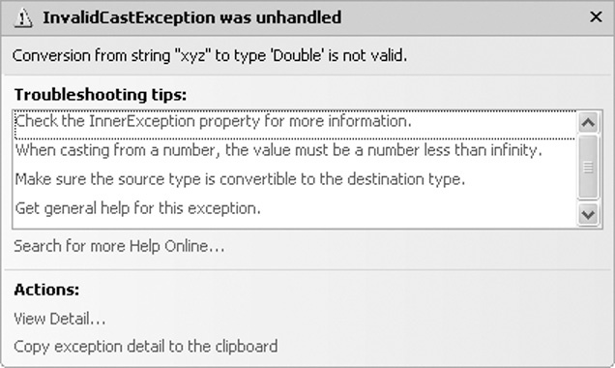
Invalid Conversions
Conversion functions can fail
Dim dblSalary As Double = CDbl("xyz")
Dim datHired As Date = CDate("5/35/2011")
String "xyz" can’t be converted to a number
There’s no day 35 in the month of May
Failed conversions
cause a runtime error called
an invalid cast exception

Slide 62
Formatting Numbers and Dates
Section 3.5
Users of computer programs generally like to see numbers and dates displayed in an attractive, easy to read format. Numbers greater than 999, for instance, should usually be displayed with commas and decimal points. The value 123456.78 would normally be displayed as “123,456.78”.

Slide 63
The ToString Method
Converts the contents of a variable as a string
Every VB data type has a ToString method
Uses the form VariableName.ToString
  Value in VariableName is converted to a string
For example:
Dim number As Integer = 123
lblNumber.text = number.ToString
  Converts integer 123 to string "123"
  Then assigns the string to the text property of the lblNumber control

Slide 64
ToString Method with Format String
Can pass a format string to the ToString method
Indicates how you want to format the string
For example
Dim dblSample As Double
Dim strResult As String
dblSample = 1234.5
strResult = dblSample.ToString("c")
The value "c" is a format string
Converts 1234.5 to currency format $1,234.50

Slide 65
Types of Format Strings
Format String | Description
N or n | Number format includes commas and displays 2 digits to the right of the decimal
F or f | Fixed point format 2 digits to the right of the decimal but no commas
E or e | Exponential format displays values in scientific notation with a single digit to the left of the decimal point. The exponent is marked by the letter e, and the exponent has a leading + or - sign.
C or c | Currency format includes dollar sign, commas, and 2 digits to the right of the decimal
P or p | Percent format multiplies number by 100 and displays with a trailing space and percent sign

Slide 66
Specifying Decimal Precision
Can add an integer to the format string to indicate number of digits to display after the decimal point
Rounding occurs when displaying fewer decimal positions than the number contains as in the 2nd line
Number Value | Format String | ToString() Value
12.3 | n3 | 12.300
12.348 | n2 | 12.35
1234567.1 | n | 1,234,567.10
123456.0 | f2 | 123456.00
123456.0 | e3 | 1.235e+005
.234 | p | 23.40%
–1234567.8 | c | ($1,234,567.80)

Slide 67
Specifying Integer Leading Zeros
Can specify a minimum width when displaying an integer value
Leading zeros are inserted to meet the minimum width if needed
Number Value | Format String | ToString() Value
23 | D | 23
23 | D4 | 0023
1 | D2 | 01

Slide 68
Formatting Dates and Times
The ToString method can format a Date or DateTime value in a variety of ways
If the date is 8/10/2010 and the time is 3:22 PM
Tutorial 3-8 provides an opportunity to work with number formatting concepts
Format String | Description | ToString() Value
d | Short Date | "8/10/2010"
D | Long Date | "Tuesday, August 10, 2010"
t | Short Time | "3:22 PM"
T | Long Time | "3:22:00 PM"
F | Long Date & Time | "Tuesday August 10, 2010 3:22:00 PM"

Slide 69
Class-Level Variables
Section 3.6
Class-level variables are accessible to all procedures in a class.

Slide 70
Class-Level Variables
A variable declared inside a class but outside any procedure is a class-level variable
  Scope is throughout all procedures of the class
Take care when using class-level variables:
  Tracking down logic errors can be time consuming because many statements can access the variable
  Make sure not to upset the accuracy of variables that are used in multiple procedures
  Because all statement can access the variables, you must be aware of every statement that has access

Slide 71
Class-Level Constants
A class-level constant is a named constant declared with the Const keyword, at the class level
Class-level constants cannot be changed during runtime
  eliminates many of the potential hazards that are associated with the use of class-level variables
  generally more acceptable to use than class-level variables

Slide 72
Class-Level Declarations
    Public Class Form1
    ' Begin after class declaration.
    ' Declare a class-level constant.
    Dim Const intVALUE As Integer = 0
    ' Declare a class-level variable.
    Dim intValue As Integer
    ' End before procedure declarations.
    Private Sub Procedure()
    End Sub
    End Class

Slide 73
Exception Handling
Section 3.7
A well-engineered program should report errors and try to
continue. Or, it should explain why it cannot continue, and then
shut down. In this section, you learn how to recover gracefully
from errors, using a technique known as exception handling.

Slide 74
Runtime Errors
We’ve shown two possible runtime errors
  DivideByZeroException
  InvalidCastException
  There are many others
Runtime errors occur for may reasons
A runtime error results when:
  Visual Basic throws an exception
  And it is an unhandled exception
Exception handling allows a program to fail gracefully and recover if possible

Slide 75
Handling Exceptions
Visual Basic provides an exception handler
The Try-Catch statement:
Try
' Try block statements…
Catch
' Catch block statements…
End Try
The try block contains program statements that might throw an exception
The catch block contains statements to execute if an exception is thrown

Slide 76
Exception Handling Example
If CDec throws a cast exception, the try block catches it, jumps to and executes the catch block which displays the error message
Try
' Get the user's input and convert it to a Decimal.
decSalary = CDec(txtSalary.Text)
' Display the user's salary.
MessageBox.Show("Your salary is " & decSalary.ToString("c"))
Catch
' Display an error message.
MessageBox.Show("Please try again, and enter a number.")
End Try

Slide 77
Group Boxes
Section 3.8
The GroupBox control is a container that is used to group other
controls together.

Slide 78
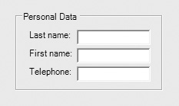
The GroupBox Control
A GroupBox creates a grouping of controls
  Controls are enclosed in
  a box with a title
  It’s apparent the controls
  within the GroupBox are related in some way
  Controls in a GroupBox have their own tab order
  Moving a GroupBox moves its controls with it
  Removing a GroupBox also removes all controls within it

Slide 79
Placing Controls Within a Group Box
Must create the GroupBox first
Then select the GroupBox control and
  Double-click the tool from the ToolBox to place the control in the group
  or
  Click and drag the control from the ToolBox to the GroupBox
To move an existing control to a GroupBox
  Select the control and cut it from the form
  Select the group and paste the control into it

Slide 80
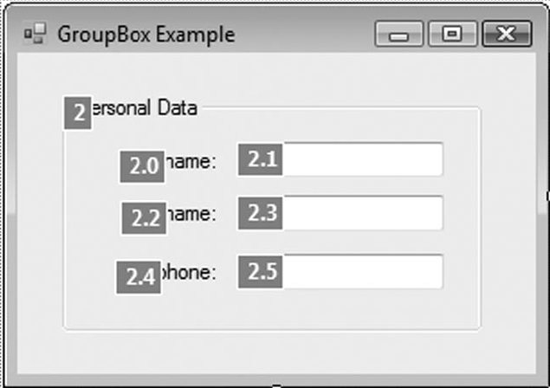
GroupBox Tab Order
A GroupBox has it’s own place in form tab order
Once the tab order reaches the GroupBox
  Must tab through all controls in the GroupBox
  before tabbing to controls outside GroupBox
  Tab order of controls inside the GroupBox
  can be assigned in any order
The GroupBox to the right
is 2nd in the form tab order
Tab order of controls in the
GroupBox is 2.1, 2.3, & 2.5

Slide 81
Selecting Multiple Controls
Multiple controls can be selected and then acted upon as a group
  Click and drag over the desired controls
  Any control partially or completely within the selection box will be selected
  Or hold the Ctrl key while clicking the controls
Once selected, a group of controls may
  Be moved together as a group
  Be deleted in a single step
  Have their properties set in a single step

Slide 82
The Load Event
Section 3.9
When an application’s form loads into memory, an event known as the
Load event takes place. You can write an event handler for the Load
event, and that handler will execute just before the form is displayed.

Slide 83
Load Event Handler
Every form has a Load event
  Executes when the form is first displayed
Double-click in any empty space on the form
  The code window will appear
  Place the code to be executed between the Private Sub and End Sub lines of the event handler
Private Sub Form1_Load(...) Handles MyBase.Load
MessageBox.Show("Prepare to see the form!")
End Sub

Slide 84
Focus on Program Design and Problem Solving:
Building the Room Charge Calculator Application
Section 3.10
The Room Charge Calculator Application applies the various concepts discussed in this chapter.

Slide 85
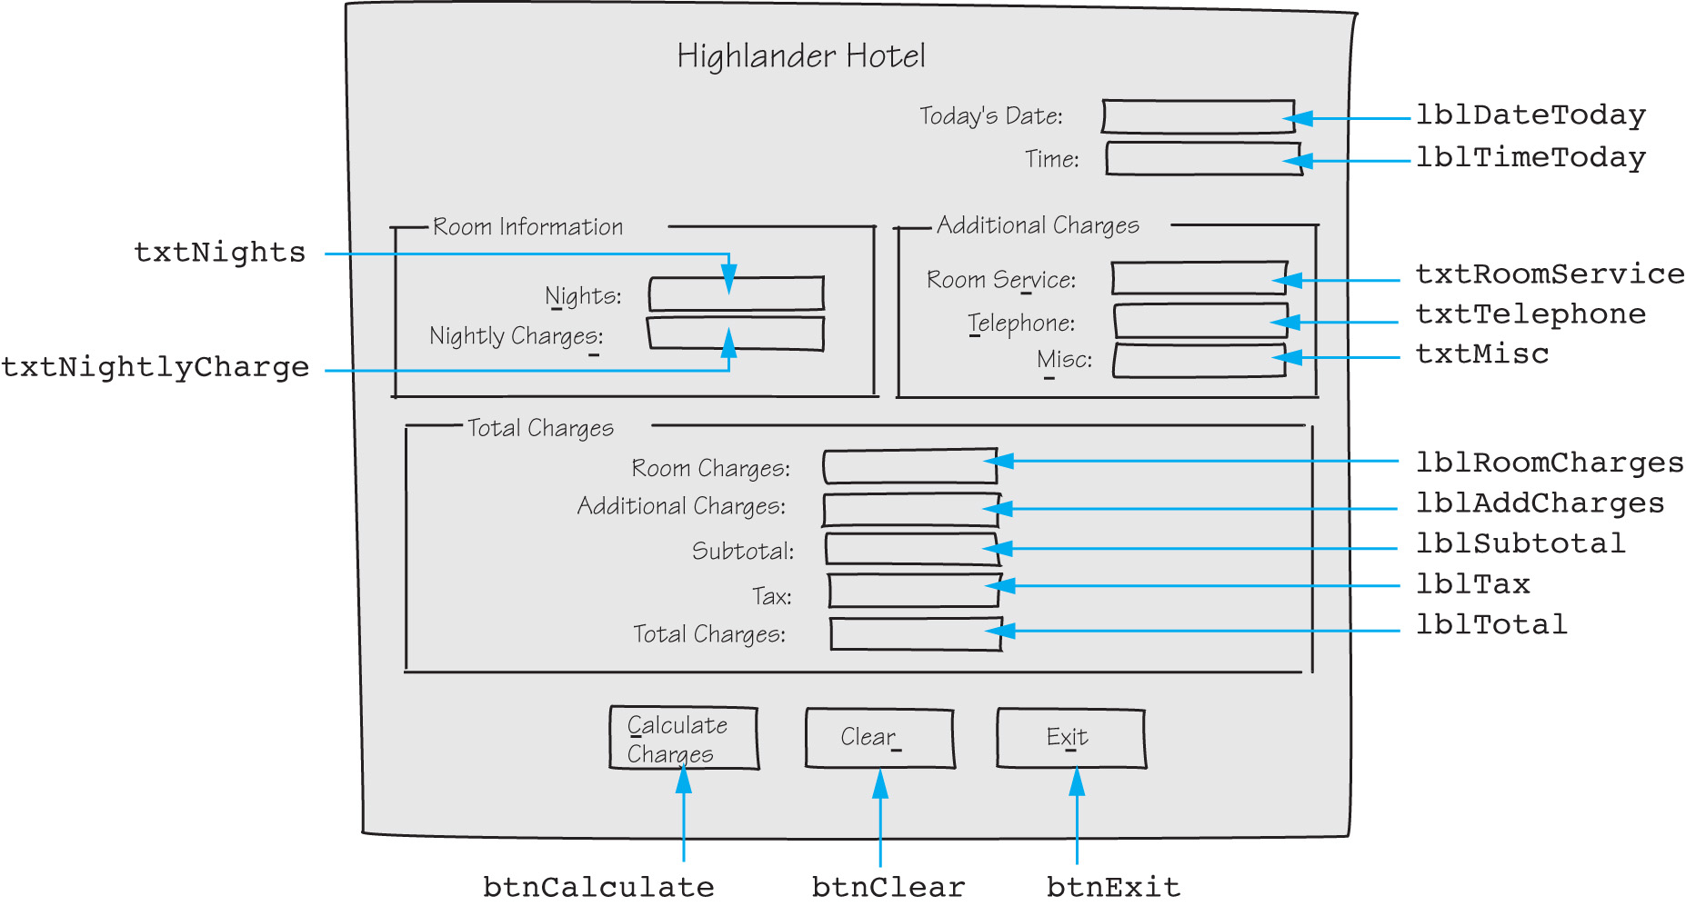
The Room Charge Calculator

Slide 86
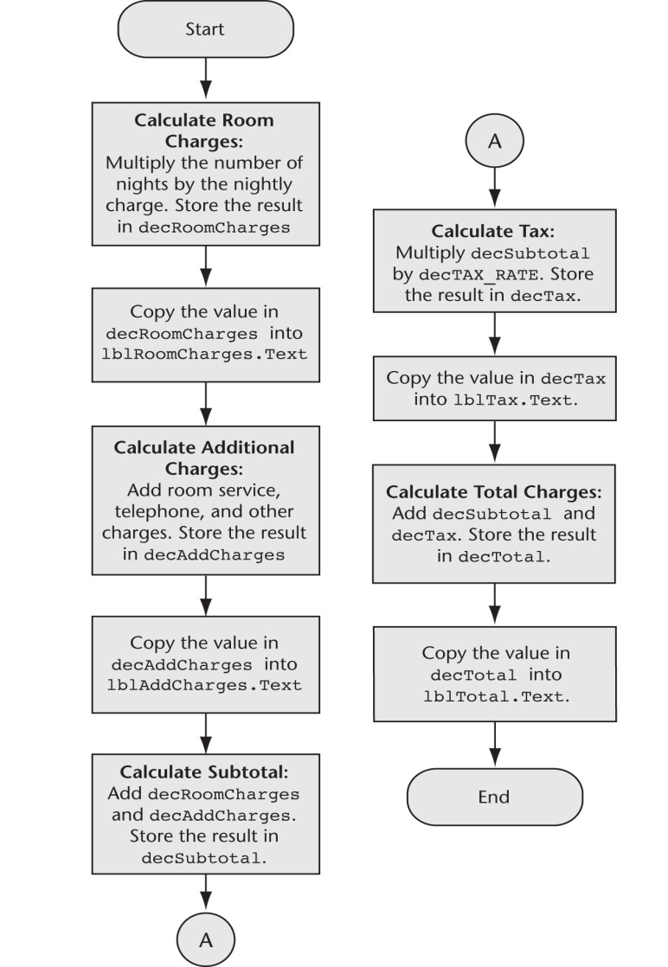
The btnCalculate Click Event

Slide 87
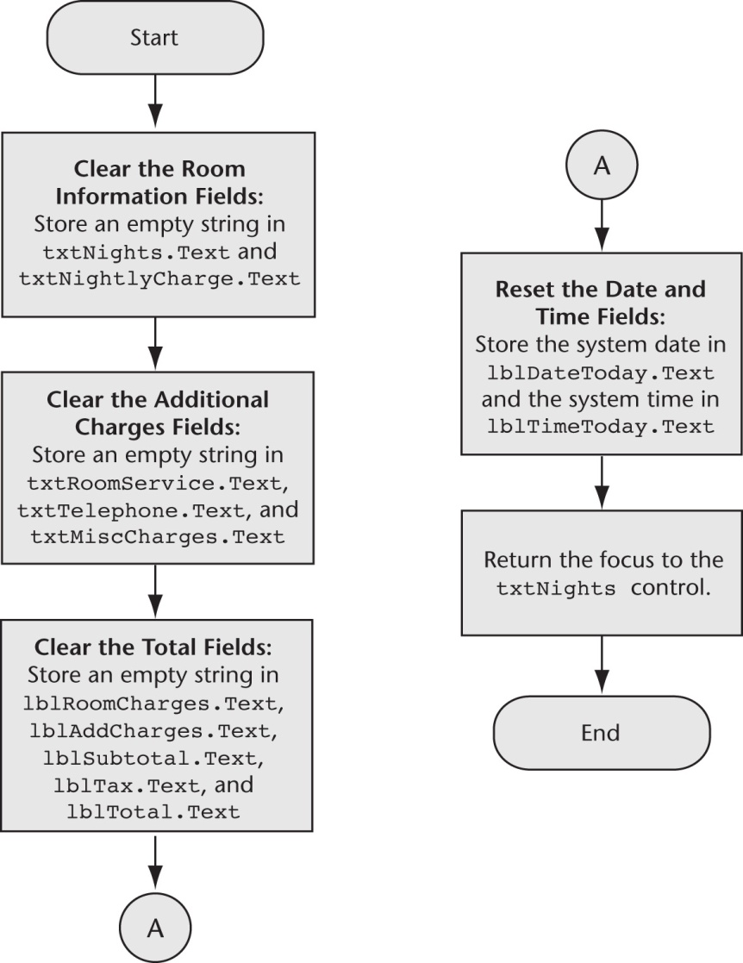
The btnClear Click Event

Slide 88
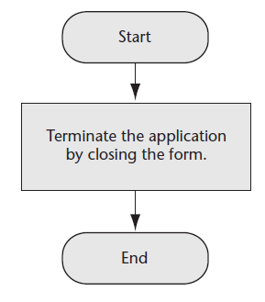
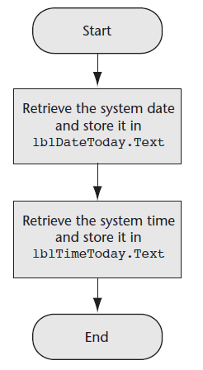
The btnExit Click Event & The Form1 Load Event

Slide 89
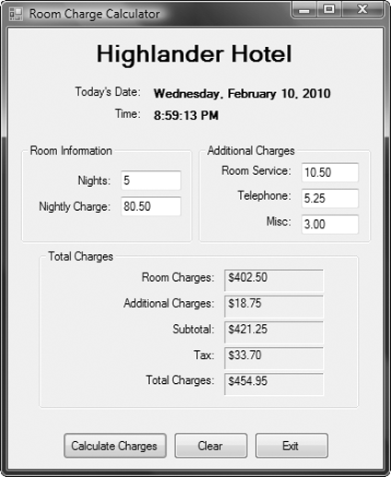
The Completed Form

Slide 90
Changing Colors with Code (Optional Topic)
You can change color properties with code
  The following code sets the label’s background color to black and foreground color to yellow:
  And the following code returns the background and foreground to the default colors:
lblMessage.BackColor = Color.Black
lblMessage.ForeColor = Color.Yellow
lblMessage.BackColor = SystemColors.Control
lblMessage.ForeColor = SystemColors.ControlText

Slide 91
More about Debugging: Locating Logic Errors
Section 3.11
Visual Studio allows you to pause a program, and then execute
statements one at a time. After each statement executes, you may
examine variable contents and property values.

Slide 92
Debugging Problem
The program runs but does not work correctly (has one or more logic errors)
Running the program with various inputs has not isolated where those logic errors lie
What can be done?

Slide 93
Visual Basic Debugging Aids
You can set breakpoints
  A line or lines you select in your source code
  When execution reaches this line, it pauses
  You may then examine the values in variables and certain control properties
  You may also single-step through the program which executes one statement at a time
This allows you to see and examine:
  What is happening one statement at a time
  Where it is happening
  What the various data values are (Watches)

Slide 94
Visual Basic Debugging Aids
Tutorial 3-13 demonstrates how to:
  Set breakpoints
  Examine the values of variables and control properties
  Use the Autos, Immediate, Locals, and Watch windows

Slide 95
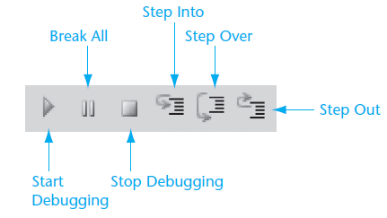
Debugging Commands in the Toolbar
Visual Studio provides a toolbar for debugging commands

