Slide 1
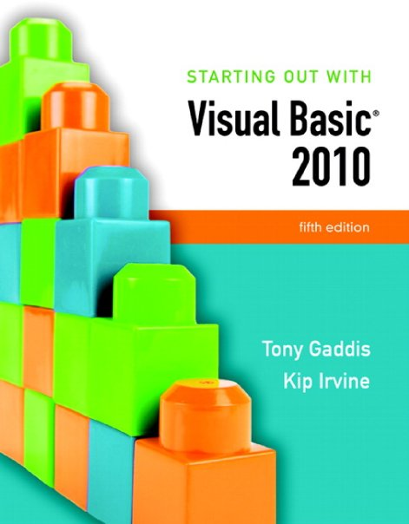

Slide 2
Chapter 8
Arrays and More

Slide 3
Introduction
Arrays are like groups of variables that allow you to store sets of similar data
  A single dimension array is useful for storing and working with a single set of data
  A multidimensional array can be used to store and work with multiple sets of data
Array programming techniques covered
  Summing and averaging all the elements in an array
  Summing all the columns in a two-dimensional array
  Searching an array for a specific value
  Using parallel arrays

Slide 4
Arrays
Section 8.1
An array is like a group of variables with one name. You store and
work with values in an array by using a subscript.

Slide 5
Array Characteristics
An array stores multiple values of same type
  Like a group of variables with a single name
For example, the days of the week might be:
  a set of 7 string variables
  with a maximum length of 9 characters
All variables within an array are called elements and must be of the same data type
You access the elements in an array through a subscript

Slide 6
Subscript Characteristics
A subscript, also called an index, is a number that identifies a specific element within an array
Subscript numbering works like a list box index:
  Subscript numbering begins at 0
  1st element in an array is always subscript 0
  Last element is total number of elements – 1
An array with 7 elements refers to the 1st element as subscript 0 and the last element as subscript 6

Slide 7
Declaring an Array
Declare an array much like a regular variable
  ArrayName is the name of the array
  UpperSubscript is the value of the array's highest subscript
    Must be a positive Integer
    Positive Integer named constant
    Or an Integer variable containing a positive number
  DataType is a Visual Basic data type
Dim ArrayName (UpperSubscript) As DataType

Slide 8
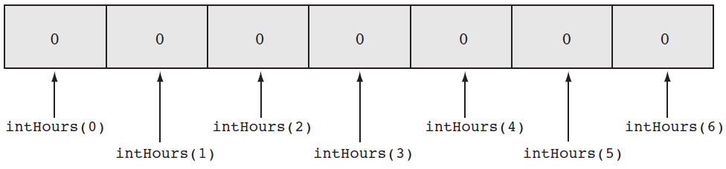
Array Declaration Example
This statement declares intHours as an array of Integers
  (6) indicates that the array’s highest subscript is 6
  Consists of seven elements with subscripts 0 through 6
  Array elements are initialized to 0
Dim intHours(6) As Integer

Slide 9
Default Initialization
All elements of an Integer array are initialized to zero
  Same initialization as an integer variable
Each array element is initialized exactly the same as a simple variable of that data type
  Decimal elements are initialized to zero (0.0)
  String elements are initialized to the special value Nothing

Slide 10
Implicit Array Sizing and Initialization
An array can be initialized when declared
Example:
This array is implicitly sized
  Upper subscript value is left blank
  Number of elements implied from initialization
  Upper subscript of 5 implied by this example
  This results in a 6 element array
Elements are assigned the values shown
Dim intNumbers() As Integer = { 2, 4, 6, 8, 10, 12 }

Slide 11
Using Named Constants as Subscripts in Array Declarations
A named constant may be used as an array's highest subscript instead of a number
This is a common use for named constants
  Highest subscript is often used multiple times
  If highest subscript changes, use of a named constant allows it to be changed in one place
Const intMAX_SUBSCRIPT As Integer = 100
Dim intArray(intMAX_SUBSCRIPT) As Integer

Slide 12
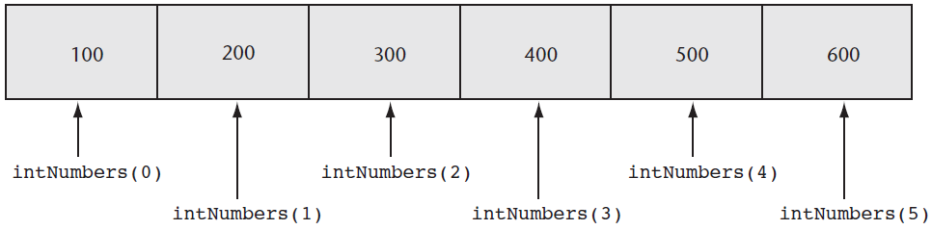
Working with Array Elements
You can store a value in an array element with an assignment statement
intNumbers(0) = 100
intNumbers(1) = 200
intNumbers(2) = 300
intNumbers(3) = 400
intNumbers(4) = 500
intNumbers(5) = 600

Slide 13
Accessing Array Elements with a Loop
Loops are frequently used to process arrays
  Using an Integer variable as a subscript
  For example, the following code stores an empty string in each element of strNames, a 1000-element array of strings:
Const intMAX_SUBSCRIPT As Integer = 999
Dim strNames(intMAX_SUBSCRIPT) As String
Dim intCount As Integer
For intCount = 0 To intMAX_SUBSCRIPT
strNames(intCount) = String.Empty
Next

Slide 14
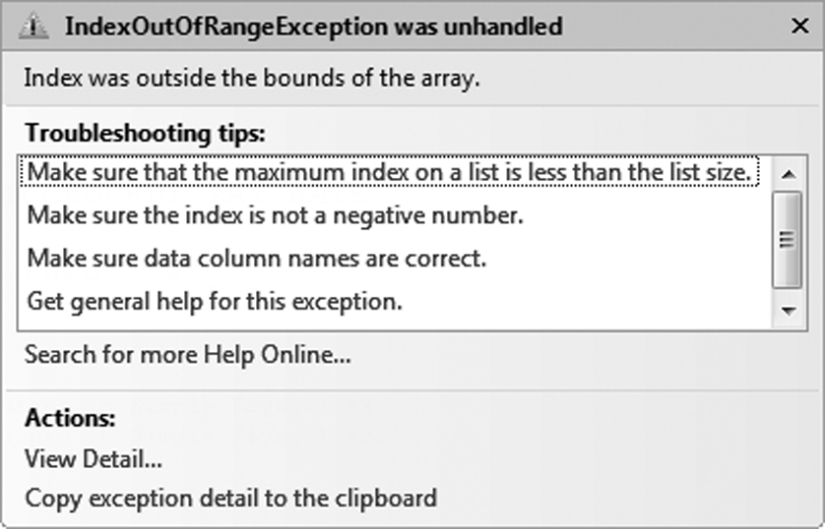
Array Bounds Checking
The Visual Basic runtime system performs array bounds checking
  It does not allow a statement to use a subscript outside the range of valid subscripts for an array
    An invalid subscript causes VB to throw a run-time exception
    Bounds checking is not done at design time

Slide 15
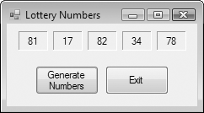
Using an Array to Hold a List of Random Numbers
In Tutorial 8-1 you will create an application that randomly generates lottery numbers
Const intMAX_SUBSCRIPT As Integer = 4
Dim intNumbers(intMAX_SUBSCRIPT) As Integer
Dim intCount As Integer
Dim rand As New Random
For intCount = 0 To intMAX_SUBSCRIPT
intNumbers(intCount) = rand.Next(100)
Next

Slide 16
Using Array Elements to Store Input
Array elements can hold data entered by the user
In Tutorial 8-2 you will create an application that
  Uses input boxes to read a sequence of strings as input
  Stores those strings in an array
Const intMAX_SUBSCRIPT As Integer = 9
Dim intSeries(intMAX_SUBSCRIPT) As Integer
Dim intCount As Integer
For intCount = 0 To intMAX_SUBSCRIPT
intSeries(intCount) = CInt(InputBox("Enter a number."))
Next

Slide 17
Getting the Length of an Array
Arrays have a Length property
  Holds the number of elements in the array
For example
  strNames.Length – 1 as the loop’s upper limit
  Length property is 1 greater than the upper subscript
Dim strNames() As String = { "Joe", "Geri", "Rose" }
For intCount = 0 to strNames.Length – 1
MessageBox.Show(strNames(intCount))
Next

Slide 18
Processing Array Contents
Array elements can be used just like regular variables in operations
  For example
    Multiplication
    Addition
    Format String
In Tutorial 8-3 you will complete an application that performs calculations using array elements
decGrossPay = intHours(3) * decPayRate
intTallies(0) += 1
MessageBox.Show(decPay(5).ToString("c"))

Slide 19
Accessing Array Elements with a For Each Loop
The For Each loop can simplify array processing
  Retrieves the value of each element
  Cannot modify values
Here is the general format:
  var is the name of a variable just for use with the loop
  type is the data type of the array
  array is the name of an array
For example, suppose we have the following array declaration:
The following For Each loop displays all the values in a list box named lstShow:
Dim intArray() As Integer = {10, 20,
30, 40,
50, 60}
For Each var As type In array
statements
Next
For Each intVal As Integer In intArray
lstShow.Items.Add(intVal)
Next

Slide 20
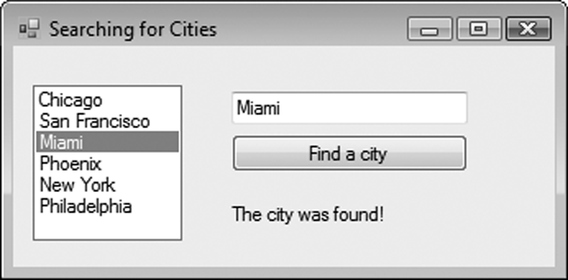
Optional Topic: Using the For Each Loop with a ListBox
A For Each loop can also be used to process items in a collection
  For example, to search for a city name in the Items collection of a ListBox control named lstCities
For Each strCity As String In lstCities.Items
If strCity = txtCity.Text Then
lblResult.Text = "The city was found!"
End If
Next

Slide 21
More About Array Processing
Section 8.2
There are many uses for arrays, and many programming techniques
can be applied to them. You can total values and search for data.
Related information may be stored in multiple parallel arrays. In
addition, arrays can be resized at runtime.

Slide 22
How to Total the Values in a Numeric Array
To total the values in a numeric array
  Use a For…Next loop with an accumulator variable
Const intMAX_SUBSCRIPT As Integer = 24
Dim intUnits(intMAX_SUBSCRIPT) As Integer
Dim intTotal As Integer = 0
Dim intCount As Integer
For intCount = 0 To (intUnits.Length – 1)
intTotal += intUnits(intCount)
Next

Slide 23
How to Total the Values in a Numeric Array
You can also use a For Each loop with an accumulator variable
Const intMAX_SUBSCRIPT As Integer = 24
Dim intUnits(intMAX_SUBSCRIPT) As Integer
Dim intTotal As Integer = 0
For Each intVal As Integer In intUnits
intTotal += intVal
Next

Slide 24
Calculating the Average Value in a Numeric Array
Sum the values in the array
Divide the sum by the number of elements
Const intMAX_SUBSCRIPT As Integer = 24
Dim intUnits(intMAX_SUBSCRIPT) As Integer
Dim intTotal As Integer = 0
Dim dblAverage As Double
Dim intCount As Integer
For intCount = 0 To (intUnits.Length – 1)
intTotal += intUnits(intCount)
Next
' Use floating-point division to compute the average.
dblAverage = intTotal / intUnits.Length

Slide 25
Find the Highest and Lowest Values in an Integer Array
Highest Value
Lowest Value
Dim intUnits() As Integer = {1, 2, 3, 4, 5}
Dim intCount As Integer
Dim intHighest As Integer
' Get the first element.
intHighest = intUnits(0)
' Search for the highest value.
For intCount = 1 To (intUnits.Length - 1)
If intUnits(intCount) > intHighest Then
intHighest = intNumbers(intCount)
End If
Next
Dim intUnits() As Integer = {1, 2, 3, 4, 5}
Dim intCount As Integer
Dim intLowest As Integer
' Get the first element.
intLowest = intUnits(0)
' Search for the lowest value.
For intCount = 1 To (intUnits.Length - 1)
If intUnits(intCount) < intLowest Then
intLowest = intNumbers(intCount)
End If
Next

Slide 26
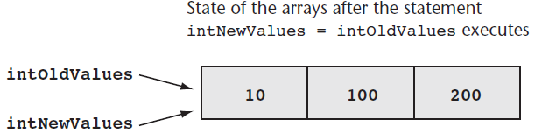
Copying One Array’s Contents to Another
A single assignment statement
  Does not copy array values into another array
  Causes both array names to reference the same array in memory
A loop must be used to copy individual elements from one array to another
For intCount = 0 To (intOldValues.Length-1)
intNewValues(intCount) = intOldValues(intCount)
Next

Slide 27
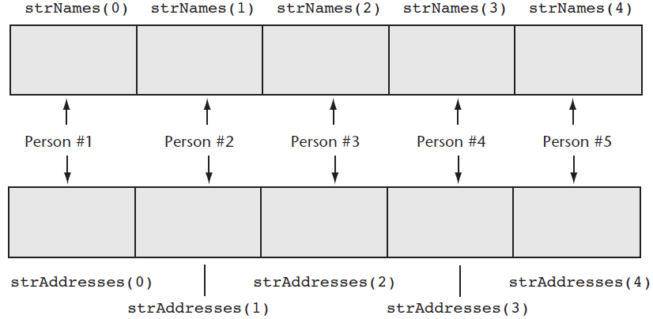
Parallel Arrays
Related data in multiple arrays can be accessed using the same subscript
Tutorial 8-4 examines an application that uses parallel arrays

Slide 28
Parallel Relationships between Arrays, List Boxes, and Combo Boxes
' A list box with names
lstPeople.Items.Add("Jean James") ' Index 0
lstPeople.Items.Add("Kevin Smith") ' Index 1
lstPeople.Items.Add("Joe Harrison") ' Index 2
' An array with corresponding phone numbers
phoneNumbers(0) = "555-2987" ' Element 0
phoneNumbers(1) = "555-5656" ' Element 1
phoneNumbers(2) = "555-8897" ' Element 2
' Display the phone number for the selected person’s name.
If lstPeople.SelectedIndex > -1 And
lstPeople.SelectedIndex < phoneNumbers.Length Then
MessageBox.Show(phoneNumbers(lstPeople.SelectedIndex))
Else
MessageBox.Show("That is not a valid selection.")
End If

Slide 29
Searching Arrays
The most basic method of searching an array is the sequential search
  Uses a loop to examine elements in the array
  Compares each element with the search value
  Stops when the value is found or the end of the array is reached
The Pseudocode for a sequential search is as follows:
found = False
subscript = 0
Do While found is False and
subscript < array's length
If array(subscript) = searchValue Then
found = True
position = subscript
End If
subscript += 1
End While

Slide 30
Sorting an Array
Programmers often want to sort, or arrange the elements of an array in ascending order
  Values are arranged from lowest to highest
    Lowest value is stored in the first element
    Highest value is stored in the last element
To sort an array in ascending order
  Use the Array.Sort method
Here is the general format:
ArrayName is the name of the array you want to sort
  For example:
After the statement executes, the array values are in the following order
  1, 3, 6, 7, 12
Array.Sort(ArrayName)
Dim intNumbers() As Integer = {7, 12,
1, 6, 3}
Array.Sort(intNumbers)

Slide 31
Sorting an Array
When you pass an array of strings to the Array.Sort method the array is sorted in ascending order
  According to the Unicode encoding scheme
  Sort occurs in alphabetic order
    Numeric digits first
    Uppercase letters second
    Lowercase letters last
For example:
After the statement executes, the values in the array appear in this order:
  "Adam", "Bill", "Kim", "dan"
Dim strNames() As String = {"dan",
"Kim",
"Adam",
"Bill"}
Array.Sort(strNames)

Slide 32
Dynamically Sizing Arrays
You can change the number of elements in an array at runtime, using the ReDim statement
  Preserve is optional
    If used, the existing values of the array are preserved
    If not, the existing values are destroyed
  Arrayname is the name of the array being resized
  UpperSubscript is the new upper subscript
    Must be a positive whole number
    If smaller that it was, elements at the end are lost
ReDim [Preserve] Arrayname (UpperSubscript)

Slide 33
Dynamically Sizing Arrays Example
You can initially declare an array with no size, as follows:
  Then prompt the user for the number of elements
  And resize the array based on user input
Dim dblScores() As Double
intNumScores = CInt(InputBox("Enter the number of test scores."))
If intNumScores > 0 Then
ReDim dblScores (intNumScores - 1)
Else
MessageBox.Show("You must enter 1 or greater.")
End If

Slide 34
Procedures and Functions
That Work with Arrays
Section 8.3
You can pass arrays as arguments to procedures and functions. You
can return an array from a function. These capabilities allow you to
write procedures and functions that perform general operations
with arrays.

Slide 35
Passing Arrays as Arguments
Procedures can be written to process the data in arrays
  Store data in an array
  Display an array’s contents
  Sum or average the values in an array
Usually such procedures accept an array as an argument
  Pass the name of the array as the argument to the procedure or function
' The DisplaySum procedure displays the
' sum of the elements in the argument array.
Sub DisplaySum(ByVal intArray() As Integer)
Dim intTotal As Integer = 0 ' Accumulator
Dim intCount As Integer ' Loop counter
For intCount = 0 To (intArray.Length - 1)
intTotal += intArray(intCount)
Next
MessageBox.Show("The total is " &
intTotal.ToString())
End Sub
Dim intNumbers() As Integer = { 2, 4, 7, 9, 8, 12, 10 }
DisplaySum(intNumbers)

Slide 36
Passing Arrays by Value and by Reference
Array arguments can be accessed and modified if passed ByVal or ByRef
  ByVal prevents an array from being assigned to another array
  ByRef allows an array to be assigned to another array
After the ResetValues procedure executes
  If passed ByVal, intNumbers is unchanged and keeps the values { 1, 2, 3, 4, 5 }
  If passed ByRef, intNumbers will reference the newArray values { 0, 0, 0, 0, 0 }
Dim intNumbers() As Integer = { 1, 2, 3, 4, 5 }
ResetValues(intNumbers)
Sub ResetValues(ByVal intArray() As Integer)
Dim newArray() As Integer = {0, 0, 0, 0, 0}
intArray = newArray
End Sub

Slide 37
Returning an Array from a Function
' Get three names from the user and return them as an array of strings.
Function GetNames() As String()
Const intMAX_SUBSCRIPT As Integer = 2
Dim strNames(intMAX_SUBSCRIPT) As String
Dim intCount As Integer
For intCount = 0 To 3
strNames(intCount) = InputBox("Enter name " & (intCount + 1).ToString())
Next
Return strNames
End Function
In Tutorial 8-5, you examine an application containing several functions that work with arrays
Dim strCustomers() As String
strCustomers = GetNames()
An array returned from a function must be assigned to an array of the same type

Slide 38
Multidimensional Arrays
Section 8.4
You may create arrays with more than two dimensions to hold complex sets of data

Slide 39
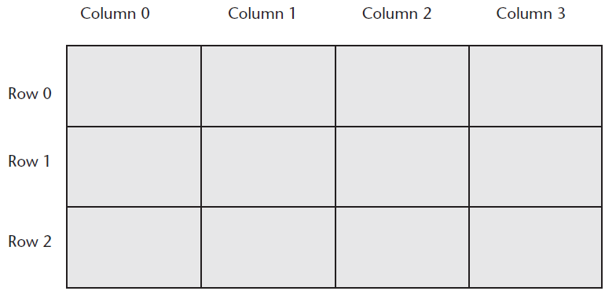
Two-Dimensional Arrays
An array with one subscript is called a one-dimensional array
  Useful for storing and working with a single set of data
A two-dimensional array is like an array of arrays
  Used to hold multiple sets of values
  Think of it as having rows and columns of elements

Slide 40
Declaring a Two-Dimensional Array
A two-dimensional array declaration requires two sets of upper subscripts
  First upper subscript is for the rows
  Second upper subscript for the columns
    ArrayName is the name of the array
    UpperRow is the value of the highest row subscript
      Must be a positive integer
    UpperColumn is the value of the highest column subscript
      Must be a positive integer
    DataType is the Visual Basic data type
Example declaration with three rows and four columns:
Dim ArrayName (UpperRow,UpperColumn) As DataType
Dim dblScores (2, 3) As Double

Slide 41
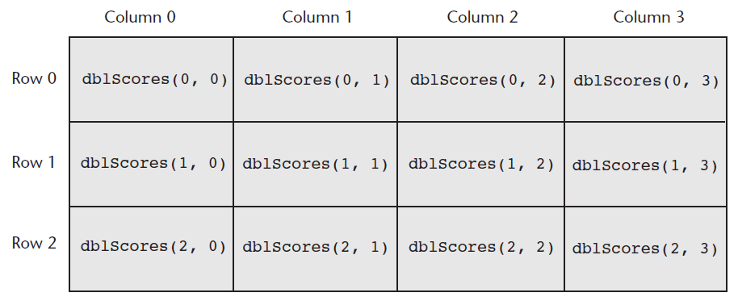
Processing Data in Two-Dimensional Arrays
Use named constants to specify the upper subscripts
Const intMAX_ROW As Integer = 2
Const intMAX_COL As Integer = 3
Dim dblScores(intMAX_ROW, intMAX_COL) As Double

Slide 42
Processing Data in Two-Dimensional Arrays
The elements in row 0 are referenced as follows:
The elements in row 1 are referenced as follows:
The elements in row 2 are referenced as follows:
dblScores(0, 0) ' Element in row 0, column 0
dblScores(0, 1) ' Element in row 0, column 1
dblScores(0, 2) ' Element in row 0, column 2
dblScores(0, 3) ' Element in row 0, column 3
dblScores(1, 0) ' Element in row 1, column 0
dblScores(1, 1) ' Element in row 1, column 1
dblScores(1, 2) ' Element in row 1, column 2
dblScores(1, 3) ' Element in row 1, column 3
dblScores(2, 0) ' Element in row 2, column 0
dblScores(2, 1) ' Element in row 2, column 1
dblScores(2, 2) ' Element in row 2, column 2
dblScores(2, 3) ' Element in row 2, column 3

Slide 43
Processing Data in Two-Dimensional Arrays
Example of storing a number in a single element
Example of prompting the user for input, once for each element
Example of displaying all of the elements in the array
dblScores(2, 1) = 95
For intRow = 0 To intMAX_ROW
For intCol = 0 To intMAX_COL
dblScores(intRow, intCol) = CDbl(InputBox("Enter a score."))
Next
Next
For intRow = 0 To intMAX_ROW
For intCol = 0 To intMAX_COL
lstOutput.Items.Add(dblScores(intRow, intCol).ToString())
Next
Next

Slide 44
Implicit Sizing and Initialization of Two-Dimensional Arrays
When providing an initialization list for a two-dimensional array, keep in mind that:
  You cannot provide the upper subscript numbers
  You must provide a comma to indicate the number of dimensions
  Values for each row are enclosed in their own set of braces
This statement declares an array with three rows and three columns:
Dim intNumbers(,) As Integer = { {1, 2, 3} ,
{4, 5, 6} ,
{7, 8, 9} }
intNumbers(0, 0) is set to 1
intNumbers(0, 1) is set to 2
intNumbers(0, 2) is set to 3
intNumbers(1, 0) is set to 4
intNumbers(1, 1) is set to 5
intNumbers(1, 2) is set to 6
intNumbers(2, 0) is set to 7
intNumbers(2, 1) is set to 8
intNumbers(2, 2) is set to 9

Slide 45
Summing the Columns of a Two-Dimensional Array
The outer loop controls the column subscript
The inner loop controls the row subscript
Tutorial 8-6 uses a two-dimensional array in the Seating Chart application
' Sum the columns.
For intCol = 0 To intMAX_COL
' Initialize the accumulator.
intTotal = 0
' Sum all rows within this column.
For intRow = 0 To intMAX_ROW
intTotal += intValues(intRow, intCol)
Next
' Display the sum of the column.
MessageBox.Show("Sum of column " & intCol.ToString() &
" is " & intTotal.ToString())
Next

Slide 46
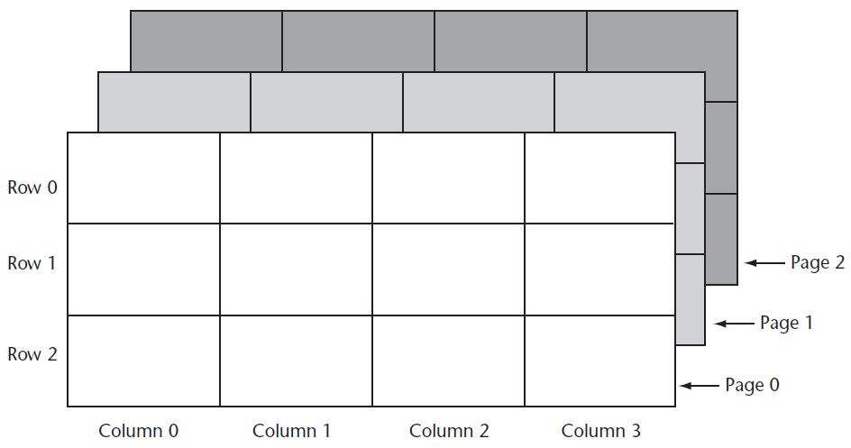
Three-Dimensional Arrays and Beyond
You can create arrays with up to 32 dimensions
The following is an example of a three-dimensional array:
Dim intPages(2, 2, 3) As Decimal

Slide 47
Three-Dimensional Arrays and Beyond
Arrays with more than three dimension are difficult to visualize
  Useful in some programming applications
  For example:
    A factory warehouse where cases of widgets are stacked on pallets, an array of four dimensions can store a part number for each widget
    The four subscripts of each element can store:
      Pallet number
      Case number
      Row number
      Column number
    A five dimensional array could be used for multiple warehouses

Slide 48
Focus on GUI Design: The Enabled Property and the Timer Control
Section 8.5
You can disable controls by setting their Enabled property to False. The Timer control allows your application to execute a procedure at regular time intervals

Slide 49
The Enabled Property
Most controls have an Enabled property
If this Boolean property is set to False the control is disabled meaning the control:
  Cannot receive the focus
  Cannot respond to user generated events
  Will appear dimmed, or grayed out
Default value for this property is True
May be set in code when needed as shown:
radBlue.Enabled = False

Slide 50
The Timer Control
The Timer control allows an application to automatically execute code at regular intervals
To place a Timer control on a form:
  Double-click the Timer icon in Components section of the Toolbox
  Appears in the component tray at design time
  Prefix a Timer control’s name with tmr
To create a Tick event handler code template:
  Double-click a Timer control that has been added to the Component tray
  Code will be executed at regular intervals

Slide 51
Timer Control Properties
Timer control has two important properties:
  The Enabled property
    Must be set to True to respond to Tick events
  The Interval property
    The number of milliseconds that elapse between events
Tutorial 8-7 demonstrates the Timer control
In Tutorial 8-8 you will use the Timer control to create a game application

Slide 52
Focus on GUI Design: Anchoring and Docking Controls
Section 8.6
Controls have two properties, Anchor and Dock, which allow you to control the control’s position on the form when the form is resized at runtime.

Slide 53
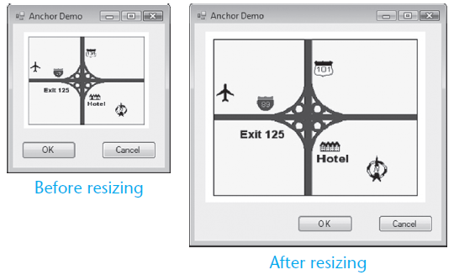
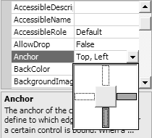
The Anchor Property
The Anchor property allows you to anchor the control to one or more edges of a form
  Controls are anchored to the top and left edges of the form by default

Slide 54
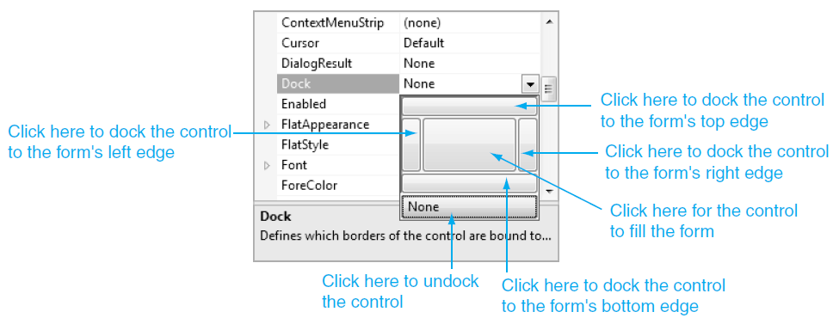
The Dock Property
The Dock property docks a control against a form’s edge
  Buttons are automatically sized to fill up in edge which they are docked

Slide 55
Focus on Problem Solving: Building the Demetris Leadership Center Application
Section 8.7
In this section you build an application that uses data stored in parallel arrays.

Slide 56
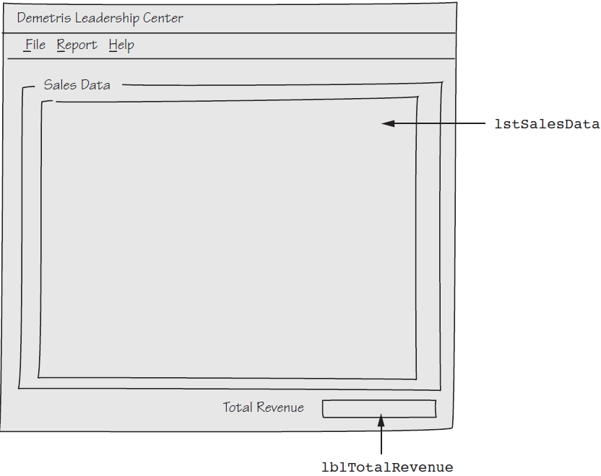
The Application’s Form

Slide 57
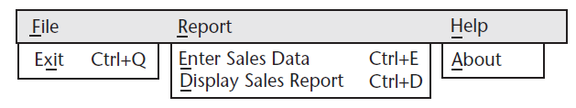
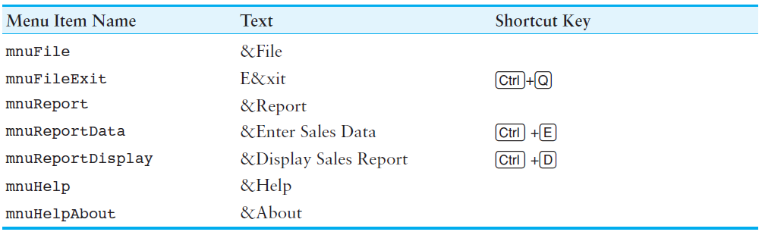
The Menu System

Slide 58
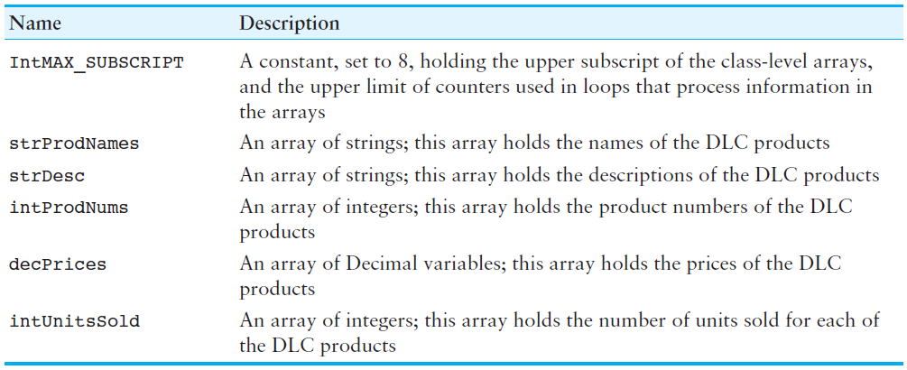
Class-Level Declarations

Slide 59
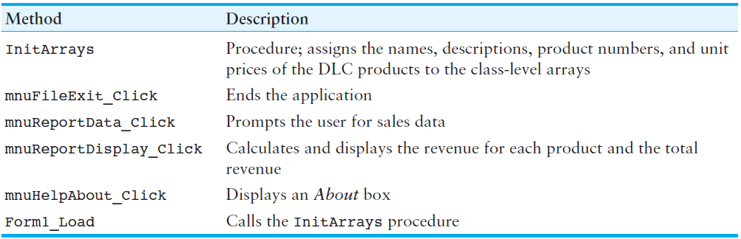
Methods

Slide 60
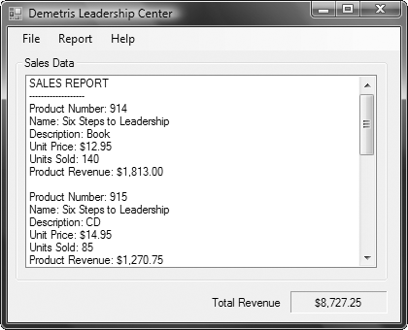
Sales Report Displayed

