Slide 1
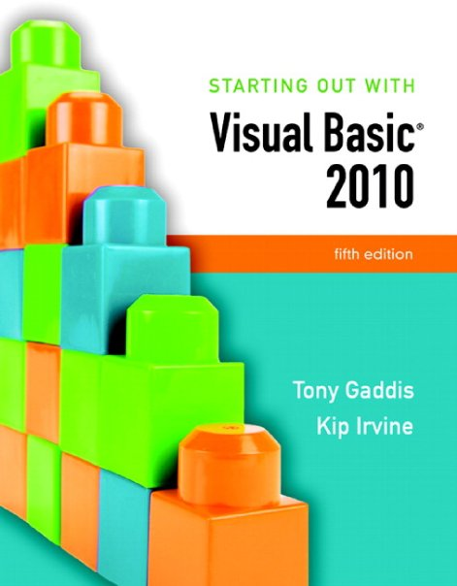

Slide 2
Chapter 9
Files, Printing, and Structures

Slide 3
Introduction
In this chapter you will learn how to:
  Save data to sequential text files
  Read data from the files back into the application
  Use the OpenFileDialog, SaveFileDialog, ColorDialog, and FontDialog controls
    For opening and saving files and for selecting colors and fonts with standard Windows dialog boxes
  Use the PrintDocument control
    To print reports from your application
  Package units of data together into structures

Slide 4
Using Files
Section 9.1
A file is a collection of data stored on a computer disk.
Data can be saved in a file and later reused.

Slide 5
Data Can be Stored in a File
Thus far, all of our data has been stored in controls and variables existing in RAM
This data disappears once the program stops running
If data is stored in a file on a computer disk, it can be retrieved and used at a later time

Slide 6
The Process of Using a File
The following steps must be taken when a file is used by an application:
  The file must be opened; If it does not yet exist, it must be created
  Data is written to the file or read from the file
  When the application is finished using the file, the file is closed

Slide 7
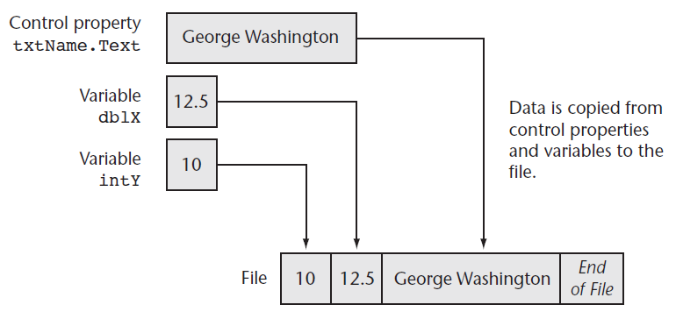
Output File
An output file is a file into which a program writes data

Slide 8
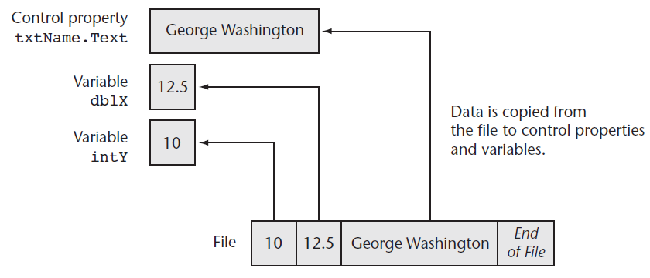
Input File
An input file is a file from which a program reads data

Slide 9
File Types
There are two types of files:
  Text
  Binary
A text file contains plain text and may be opened in a text editor such as Windows Notepad
Binary files contain pure binary data and cannot usually be viewed with a text editor

Slide 10
File Access Methods
There are two methods of accessing Files:
  Sequential-access
  Random-access
A sequential-access file is like a stream of data that must be read from beginning to end
A random-access file may be accessed in any order

Slide 11
Writing to Files with StreamWriter Objects
Two basic ways to open a file for writing
  Create a new file
  Open an existing file and append data to it
A StreamWriter object performs the actual writing to the file
Two required steps:
  Declare a StreamWriter variable
  Call either File.CreateText or File.AppendText and assign its return value to the StreamWriter variable

Slide 12
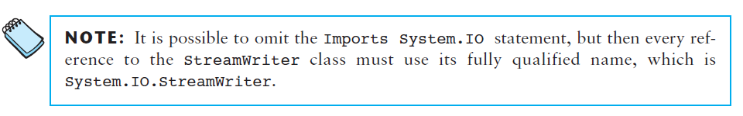
Using the Imports Statement for the StreamWriter Classes
To make the StreamWriter classes available to your program
  Insert the following Imports statement at the top of your form’s code file:
Imports System.IO

Slide 13
Creating a Text File
Declare a StreamWriter variable using the following general format:
  ObjectVar is the name of the object variable
  You may use Private or Public in place of Dim
    At the class-level or module-level
  Here’s an example:
Dim ObjectVar As StreamWriter
Dim phoneFile As StreamWriter

Slide 14
Creating a Text File
Next, call the File.CreateText method, passing the name of a file
For example:
  Notice the return value from File.CreateText is assigned to the StreamWriter variable named phoneFile
phoneFile = File.CreateText("phonelist.txt")

Slide 15
File Paths
The filename that you pass to the File.CreateText method
  Can be a complete file path with drive letter
"C:\data\vbfiles\phonelist.txt"
  Refer to a file in the default drive root directory
"\phonelist.txt"
  Include no path information at all
"phonelist.txt"
If no path information specified
  The \bin\Debug folder of the current project is used

Slide 16
Opening an Existing File and Appending Data to It
If a text file already exists, you may want to add more data to the end of the file
  This is called appending the file
First, declare a StreamWriter variable
Then call the File.AppendText method, passing the name of an existing file
  If the file does not exit it will be created
For example:
phoneFile = File.AppendText("phonelist.txt")

Slide 17
Writing Data to a File
The WriteLine method of the StreamWriter class writes a line of data to a file using the following general format:
  ObjectVar is the name of the StreamWriter object variable
  Data represents constants or variables whose contents will be written to the file
    Calling the method without the Data argument writes a blank line to the file
The WriteLine method writes the data to the file and then writes a newline character immediately after the data
  A newline character is an invisible character that separates text by breaking it into another line when displayed on the screen
ObjectVar.WriteLine(Data)

Slide 18
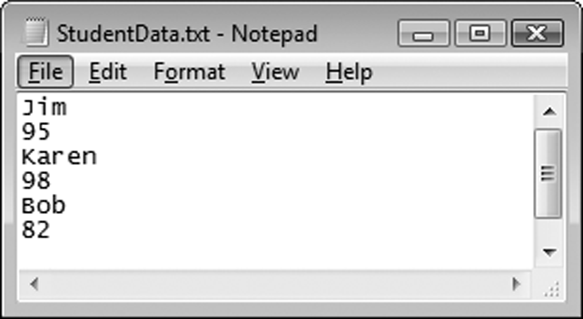
Writing Data to a File
The following writes three students’ first names and scores to a file:
In addition to separating the contents of a file into lines, the newline character also serves as a delimiter
  A delimiter is an item that separates other items
  Data must be separated in order for it to be read from a file
' Write data to the file.
studentFile.WriteLine("Jim")
studentFile.WriteLine(95)
studentFile.WriteLine("Karen")
studentFile.WriteLine(98)
studentFile.WriteLine("Bob")
studentFile.WriteLine(82)
Jim<newline>95<newline>Karen<newline>98<newline>Bob<newline>82<newline>

Slide 19
The Write Method
The Write method is a member of the StreamWriter class that writes an item of data without writing a newline character using the following general format:
  ObjectVar is the name of a StreamWriter object
  Data represents the contents of a constant or variable that is written to the file
  Writes data to a file without terminating the line with a newline character
    A blank space or comma could be used to provide a delimiter between data items
ObjectVar.Write(Data)

Slide 20
Closing a File
The StreamWriter class has a method named Close that closes a file using the following general format:
  ObjectVar is the StreamWriter object variable you want to close
    The following statement closes a StreamWriter object variable named salesFile:
The Close method
  Writes any unsaved information remaining in the file buffer
  Releases memory allocated by the StreamWriter object
Tutorial 9-1 examines an application that writes data to a file
ObjectVar.Close()
salesFile.Close()

Slide 21
Appending a File
When we append a file
  We write new data immediately following existing data in the file
If an existing file is opened with the AppendText method
  Data written to the file is appended to the file’s existing data
  If the file does not exit, it is created

Slide 22
Appending a File Example
The following example:
  Opens a file in append mode and writes additional data to the file
' Declare an object variable
Dim friendFile As StreamWriter
' Open the file.
friendFile = File.AppendText("MyFriends.txt")
' Write the data.
friendFile.WriteLine("Bill Johnson")
friendFile.WriteLine("555–4545")
' Close the file.
friendFile.Close()
Before
After
Jim Weaver
555-1212
Mary Duncan
555-2323
Karen Warren
555-3434
Jim Weaver
555-1212
Mary Duncan
555-2323
Karen Warren
555-3434
Bill Johnson
555-4545

Slide 23
Reading Files with StreamReader Objects
A StreamReader object reads data from a sequential text file
  A StreamReader object is an instance of the StreamReader class
The StreamReader class provides methods for reading data from a file
Create a StreamReader object variable using the following general format:
  ObjectVar is the name of the object variable
    You may use Private or Public in place of Dim
      At the class-level or module-level
Dim ObjectVar As StreamReader

Slide 24
Reading Files with StreamReader Objects
The File.OpenText method opens a file and stores the address of the StreamReader object variable using the following general format:
  Filename is a string or a string variable specifying the path and/or name of the file to open
    For example:
To make the StreamReader classes available
  Write the following Imports statement at the top of your code file:
File.OpenText(Filename)
Dim customerFile As StreamReader
customerFile = File.OpenText("customers.txt")
Imports System.IO

Slide 25
Reading Data from a File
The ReadLine method in the StreamReader class reads a line of data from a file using the following general format:
  ObjectVar is the name of a StreamReader object variable
  The method reads a line from the file associated with ObjectVar and returns the data as a string
    For example, the following statement reads a line from the file and stores it in the variable:
ObjectVar.ReadLine()
strCustomerName = customerFile.ReadLine()

Slide 26
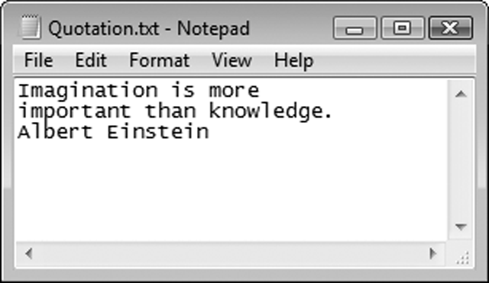


Reading Data from a File
Data is read from a file in a forward-only direction
When the file is opened
  Its read position is set to the first item in the file
As data is read
  The read position advances through the file
Dim textFile As StreamReader
textFile = File.OpenText("Quotation.txt")
strInput = textFile.ReadLine()

Slide 27
Closing the File
The StreamReader class has a method named Close that closes an open StreamReader object using the following general format:
  ObjectVar is the StreamReader object variable you want to close
    The following statement closes a StreamReader object variable named readFile:
In Tutorial 9-2, you complete an application that uses the ReadLine statement
ObjectVar.Close()
readFile.Close()

Slide 28
Determining Whether a File Exists
To determine if a file exists before opening it, you can call the File.Exists method using the following general format:
  Filename is the name of a file, which may include the path
  The method returns True if the files exists or False if the file does not exist
File.Exists(Filename)
If File.Exists(strFilename) Then
' Open the file.
inputFile = File.OpenText(strFilename)
Else
MessageBox.Show(strFilename & " does not exist.")
End If

Slide 29
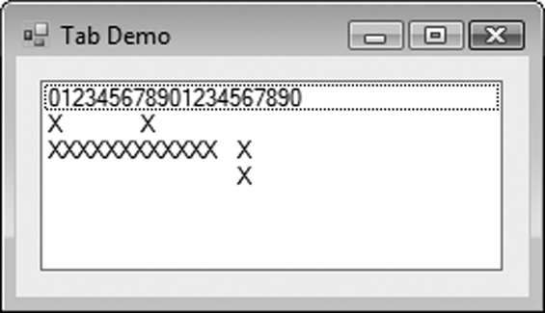
Using vbTab to Align Display Items
The predefined vbTab constant
  Moves the print position forward to the next even multiple of 8
  Can be used to align columns in displayed or printed output
ListBox1.Items.Add("012345678901234567890")
ListBox1.Items.Add("X" & vbTab & "X")
ListBox1.Items.Add("XXXXXXXXXXXX" & vbTab & "X")
ListBox1.Items.Add(vbTab & vbTab & "X")

Slide 30
Detecting the End of a File
In many cases, the amount of data in a file is unknown
Use the Peek method to determine when the end of the file has been reached
Here is the general format:
  ObjectVar is the name of a StreamReader object variable
  The method looks ahead in the file without moving the read position
  Returns the next character that will be read or -1 if no more characters can be read
The following example uses a Do Until loop and the Peek method to determine the end of the file:
Tutorial 9-3 examines an application that detects the end of a file
Dim scoresFile As StreamReader
Dim strInput As String
scoresFile = File.OpenText("Scores.txt")
Do Until scoresFile.Peek = -1
strInput = scoresFile.ReadLine()
lstResults.Items.Add(strInput)
Loop
scoresFile.Close()
ObjectVar.Peek

Slide 31
Other StreamReader Methods
The Read method reads only the next character from a file and returns the integer code for the character using the following general format:
  ObjectVar is the name of a StreamReader object
  Use the Chr function to convert the integer code to a character
ObjectVar.Read
Dim textFile As StreamReader
Dim strInput As String = String.Empty
textFile = File.OpenText("names.txt")
Do While textFile.Peek <> –1
strInput &= Chr(textFile.Read)
Loop
textFile.Close()

Slide 32
Other StreamReader Methods
The ReadToEnd method reads and returns the entire contents of a file beginning at the current read position using the following general format:
  ObjectVar is the name of a StreamReader object
ObjectVar.ReadToEnd
Dim textFile As StreamReader
Dim strInput As String
textFile = File.OpenText("names.txt")
strInput = textFile.ReadToEnd()
textFile.Close()

Slide 33
Working with Arrays and Files
The contents of an array can easily be written to a file using a loop
Dim outputFile as StreamWriter
outputFile = File.CreateText("Values.txt")
For intCount = 0 To (intValues.Length – 1)
outputFile.WriteLine(intValues(intCount))
Next
outputFile.Close()

Slide 34
Working with Arrays and Files
And it is just as easy to read the contents of a file into an array using a loop
Dim inputFile as StreamReader
inputFile = File.OpenText("Values.txt")
For intCount = 0 To (intValues.Length – 1)
intValues(intCount) = CInt(inputFile.ReadLine())
Next
inputFile.Close()

Slide 35
The OpenFileDialog, SaveFileDialog,
FontDialog, and ColorDialog Controls
Section 9.2
Visual Basic provides dialog controls that equip your applications
with standard Windows dialog boxes for operations such as opening
files, saving files, and selecting fonts and colors.

Slide 36
The OpenFileDialog and SaveFileDialog Controls
Windows has a standard method of allowing a user to choose a file to open or save
These methods let users browse for a file
  The OpenFileDialog control and SaveFileDialog control provide this capability in Visual Basic
To use the OpenFileDialog control
  Double click on the OpenFileDialog tool in the Toolbox under the Dialogs tab
  Appears in component tray
  Use ofd as standard prefix when naming
SaveFileDialog is used in a similar way

Slide 37
Displaying an Open Dialog Box
Display control with the ShowDialog method
Method returns a value indicating which dialog box button the user selects:
  Windows.Forms.DialogResult.OK for the OK button
  Windows.Forms.DialogResult.Cancel for the Cancel button
For example:
ControlName.ShowDialog()
If ofdOpenFile.ShowDialog() = Windows.Forms.DialogResult.OK Then
MessageBox.Show(ofdOpenFile.FileName)
Else
MessageBox.Show("You selected no file.")
End If

Slide 38
The Filter Property
FileDialog controls have a Filter property
  Limits files shown to specific file extensions
  Specify filter description shown to user first
  Then specify the filter itself
  Pipe symbol (|) used as a delimiter
Following Filter property lets user choose:
  Text files (*.txt), displays all .txt files
  All files (*.*), displays all file extensions

Slide 39
Other OpenFileDialog Properties
The InitialDirectory property is the initially displayed folder
The Title property specifies the text on the title bar
  The following example sets the Filter, InitialDirectory and Title properties:
' Configure the Open dialog box and display it.
With ofdOpenFile
.Filter = "Text files (*.txt)|*.txt|All files (*.*)|*.*"
.InitialDirectory = "C:\Data"
.Title = "Select a File to Open"
If.ShowDialog() = Windows.Forms.DialogResult.OK Then
inputFile = File.OpenText(.Filename)
End If
End With

Slide 40
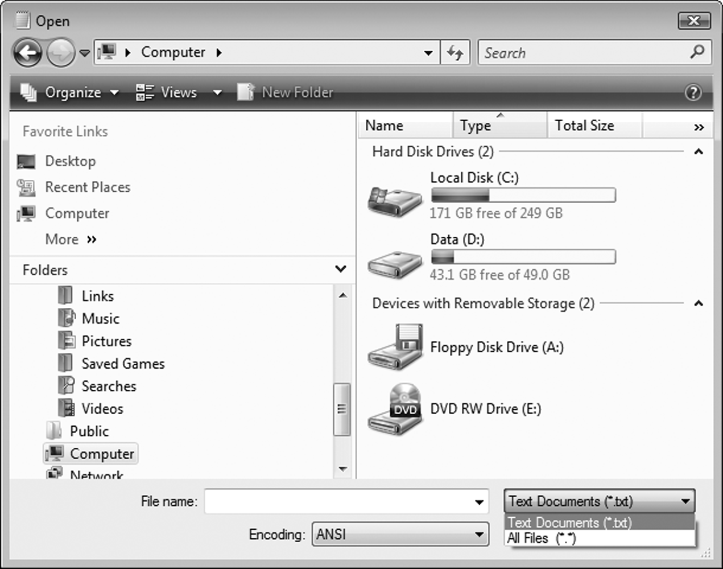
Open Dialog Box Example

Slide 41
The SaveFileDialog Control
The SaveFileDialog uses the same methods:
  ShowDialog
The same properties:
  Filter
  InitialDirectory
  Title
And the same result constants:
  Windows.Forms.DialogResult.OK
  Windows.Forms.DialogResult.Cancel
Tutorial 9-4 uses these controls in a text editor

Slide 42
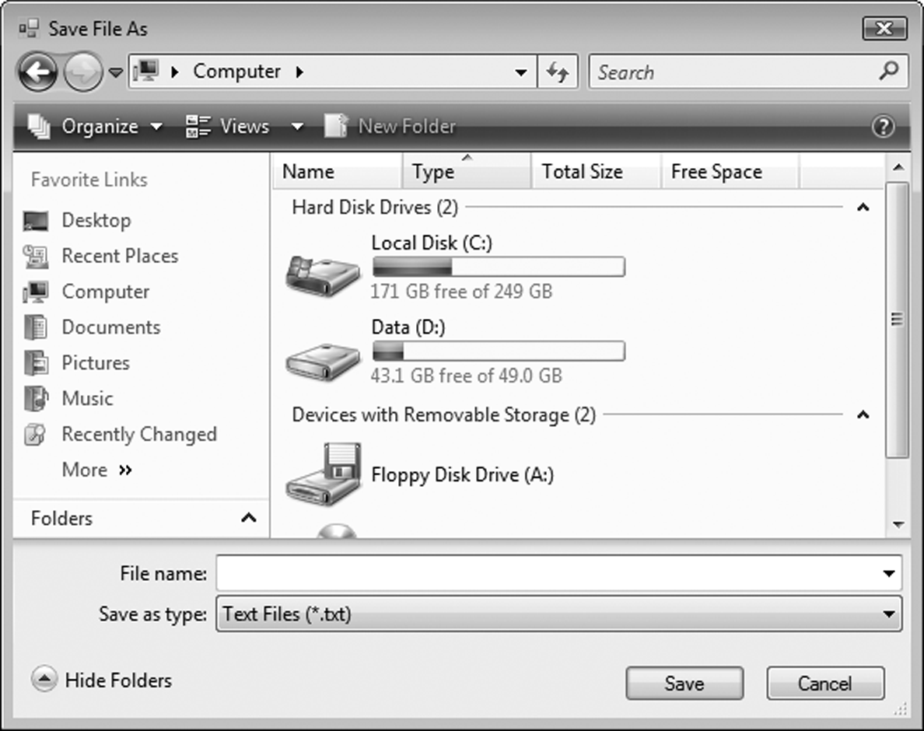
Windows Save As Dialog Box Example

Slide 43
The ColorDialog Control
The ColorDialog control displays a standard Windows Color Dialog box
  To place a ColorDialog control on a form
    Double-click the ColorDialog icon in the Dialogs section of the Toolbox
    Control appears in the component tray
    Use the prefix cd when naming the control
  To display a Color dialog box, call the ShowDialog method
    Returns one of the following values
      Windows.Forms.DialogResult.OK
      Windows.Forms.DiallogResult.Cancel

Slide 44
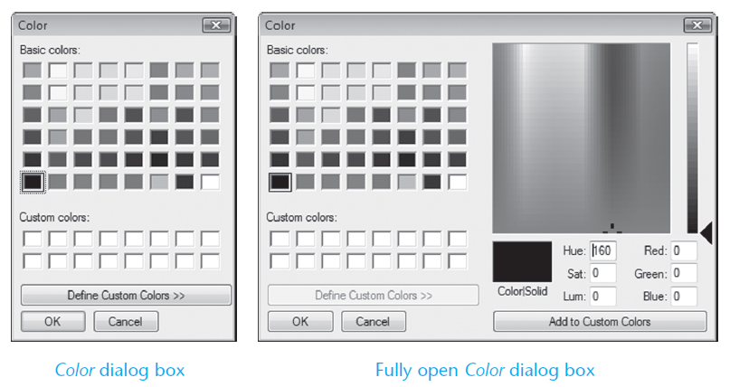
Windows Color Dialog Box Example

Slide 45
The FontDialog Control
The FontDialog control displays a standard Windows Font Dialog box
  To place a FontDialog control on a form
    Double-click the FontDialog icon in the Dialogs section of the Toolbox
    Control appears in the component tray
    Use the prefix fd when naming the control
  To display a Color dialog box, call the ShowDialog method
    Returns one of the following values
      Windows.Forms.DialogResult.OK
      Windows.Forms.DiallogResult.Cancel

Slide 46
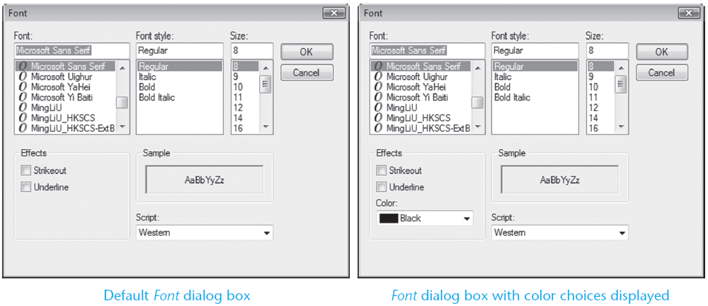
Windows Font Dialog Box Example

Slide 47
The PrintDocument Control
Section 9.3
The PrintDocument control allows you to send output to the printer.

Slide 48
The PrintDocument Control
The PrintDocument control gives your application the ability to print output on the printer
  To place a PrintDocument control on a form
    Double-click the PrintDocument tool in the Printing section of the Toolbox
    Appears in the component tray
    Use the prefix pd when naming the control

Slide 49
The Print Method and the PrintPage Event
The PrintDocument control has a Print method that starts the printing process using the following general format:
  When the method is called, it triggers a PrintPage event
  You must write code in the event handler to initiate printing
To create a PrintPage event handler code template:
  Double-click the PrintDocument control in the component tray
  The event handler code template appears in the Code window:
PrintDocumentControl.Print()
Private Sub pdPrint_PrintPage(...) Handles pdPrint.PrintPage
End Sub

Slide 50
The Print Method and the PrintPage Event
Inside the PrintPage event hander
  You write code that sends text to the printer
    Using a specified
      Font
      Color
      Location
  With the e.Graphics.DrawString method

Slide 51
The Print Method and the PrintPage Event
The e.Graphics.DrawString method uses the following general format:
  String is the string to be printed
  FontName is a string holding the name of the font to use
  Size is the size of the font in points
  Style is the font style (bold, italic, regular, strikeout, or underline)
  Brushes.Black specifies that the output should be printed in black
  Hpos is the horizontal position of the output, in points, from the left margin
  Vpos is the vertical position of the output, in points, from the top margin
In Tutorial 9-5, you will modify the Simple Text Editor application from Tutorial 9-4 by adding a Print command to the File menu
e.Graphics.DrawString(String, New Font(FontName, Size, Style), Brushes.Black, HPos, VPos)

Slide 52
PrintPage Event Handler Example
Dim inputFile As StreamReader ' Object variable
Dim intX As Integer = 10 ' X coordinate for printing
Dim intY As Integer = 10 ' Y coordinate for printing
' Open the file.
inputFile = File.OpenText(strFilename)
' Read all the lines in the file.
Do While inputFile.Peek <> -1
' Print a line from the file.
e.Graphics.DrawString(inputFile.ReadLine(),
New Font ("Courier", 10, FontStyle.Regular), Brushes.Black, intX, intY)
' Add 12 to intY
intY += 12
Loop
' Close the file.
inputFile.Close()

Slide 53
Formatted Reports with String.Format
Reports typically contain the following sections:
  A report header
    Printed first, contains general information such as
      The name of the report
      The date and time the report was printed
  The report body
    Contains the report’s data
      Often formatted in columns
  An optional report footer
    Contains the sum of one for more columns of data

Slide 54
Printing Reports with Columnar Data
Report data is typically printed in column format
With each column having an appropriate header
You can use Monospaced fonts to ensure that
  Each character takes same amount of space
  Columns will be aligned
String.Format method is used to align data along column boundaries

Slide 55
Using String.Format to Align Data along Column Boundries
The String.Format method can be used to align data along column boundaries using the following general format:
  FormatString is a string containing the formatting specifications
  Arg0 and Arg1 are values to be formatted
  The [,…] notation indicates that more arguments may follow
  The method returns a string that contains the data
  Provided by the arguments (Arg0, Arg1, etc)
  Formatted with the specifications found in FormatString
String.Format(FormatString, Arg0, Arg1 [,...])

Slide 56

The Format String
Contains three sets of numbers inside curly braces
  The first number in a set specifies the argument index number
    0 represents the index for intX
    1 represents the index for intY
    2 represents the index for intZ
  The second number in a set is an absolute value that specifies the column width, in spaces, and the type of justification that will be used
    A positive number specifies right justification
    A negative number specifies left justification

Slide 57
Example Report Header and Column Headings
Dim intCount As Integer ' Loop counter
Dim decTotal As Decimal = 0 ' Accumulator
Dim intVertPosition As Integer ' Vertical printing position
' Print the report header.
e.Graphics.DrawString("Sales Report",
New Font("Courier New", 12,FontStyle.Bold),
Brushes.Black, 150, 10)
e.Graphics.DrawString("Date and Time: " & Now.ToString(),
New Font("Courier New", 12, FontStyle.Bold),
Brushes.Black, 10, 38)
' Print the column headings.
e.Graphics.DrawString(String.Format("{0, 20} {1, 20} ","NAME", "SALES"),
New Font("Courier New", 12, FontStyle.Bold),
Brushes.Black, 10, 66)

Slide 58
Example Report Body and Footer
' Print the body of the report.
intVertPosition = 82
For intCount = 0 To 4
e.Graphics.DrawString(String.Format("{0, 20} {1, 20} ",strNames(intCount),decSales(intCount).ToString("c")),
New Font("Courier New", 12, FontStyle.Regular),
Brushes.Black, 10, intVertPosition)
decTotal += decSales(intCount)
intVertPosition += 14
Next
' Print the report footer.
e.Graphics.DrawString("Total Sales: " & decTotal.ToString("c"),
New Font("Courier New", 12, FontStyle.Bold),
Brushes.Black, 150, 165)

Slide 59
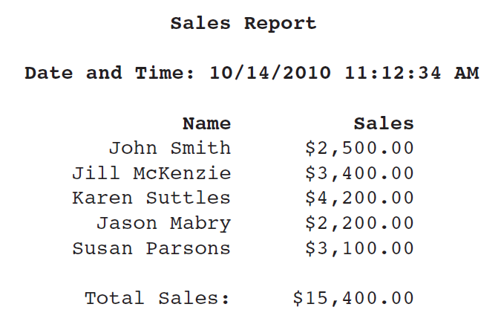
Example Report Output

Slide 60
Structures
Section 9.4
Visual Basic allows you to create your own data types, into which
you may group multiple data fields.

Slide 61
Arrays vs. Structures
Arrays:
  Multiple fields in one array
  All of the same data type
  Distinguished by a numerical index
Structures
  Multiple fields in one structure
  Can be of differing data types
  Distinguished by a field name

Slide 62
Creating a Structure
A structure is a data type you can create that contains one or more variables known as fields
You create a structure at the class or module-level with the structure statement:
  For example:
[AccessSpecifier] Structure StructureName
FieldDeclarations
End Structure
Structure EmpPayData
Dim intEmpNumber As Integer
Dim strFirstName As String
Dim strLastName As String
Dim dblHours As Double
Dim decPayRate As Decimal
Dim decGrossPay As Decimal
End Structure

Slide 63
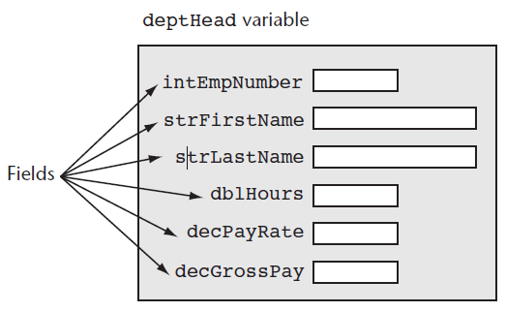
Declaring a Structure
Dim deptHead As EmpPayData
  Access each field with the dot operator
deptHead.intEmpNumber = 1101
deptHead.strFirstName = "Joanne"
deptHead.strLastName = "Smith"
deptHead.dblHours = 40.0
deptHead.decPayRate = 25
deptHead.decGrossPay = CDec(deptHead.dblHours) * deptHead.decPayRate

Slide 64
Passing Structure Variables to Procedures and Functions
Structures can be passed to procedures and functions like any other variable
The data type to use in the specification is the name of the structure
Sub CalcPay(ByRef employee As EmpPayData)
' This procedure accepts an EmpPayData variable
' as its argument. The employee's gross pay
' is calculated and stored in the grossPay
' field.
With employee
.decGrossPay =.dblHours * .decPayRate
End With
End Sub

Slide 65
Arrays as Structure Members
Structures can contain arrays
Must ReDim after declaring structure variable
Structure StudentRecord
Dim strName As String
Dim dblTestScores() As Double
End Structure
Dim student As StudentRecord
ReDim student.dblTestScores(4)
student.strName = "Mary McBride"
student.dblTestScores(0) = 89.0
student.dblTestScores(1) = 92.0
student.dblTestScores(2) = 84.0
student.dblTestScores(3) = 96.0
student.dblTestScores(4) = 91.0

Slide 66
Arrays of Structures
Can declare an array of structures
Example below declares employees as an array of type EmpPayData with 10 elements
  To access individual elements in the array, use a subscript
  Us the ReDim statement to set the size of each array field
Tutorial 9-6 examines an application that uses a structure
Const intMAX_SUBSCRIPT As Integer = 9
Dim employees(intMAX_SUBSCRIPT) As EmpPayData
employees(0).intEmpNumber = 1101
For intIndex = 0 To intMax_SUBSCRIPT
ReDim students(intIndex).dblTestScores(4)
Next

