Slide 1
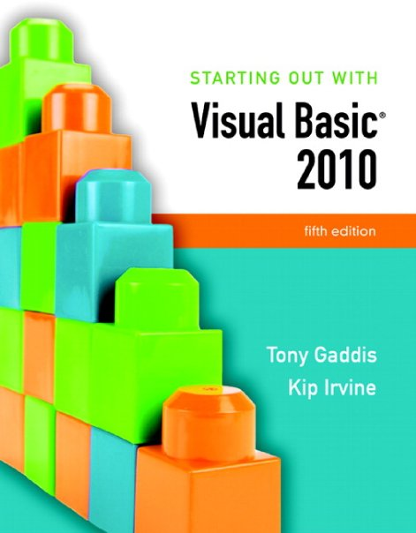

Slide 2
Chapter 10
Working with Databases

Slide 3
Introduction
In this chapter you will learn:
  Basic database concepts
  How to write Visual Basic applications that interact with databases
  How to use a DataGridView control and display the data in a database
  How to sort and update database data
  To create an application that displays database data in list boxes, text boxes, labels, and combo boxes

Slide 4
Database Management Systems
Section 10.1
Visual Basic applications use database management systems to
make large amounts of data available to programs.

Slide 5
Visual Basic and Database Management Systems
Simple text files as shown in chapter 9 are:
  Fine for small amounts of data
  But impractical for large amounts of data
Businesses must maintain huge amounts of data
  A database management system (DBMS) is the typical solution to the data needs of business
  Designed to store, retrieve, and manipulate data
Visual Basic can communicate with a DBMS
  Tells DBMS what data to retrieve or manipulate

Slide 6
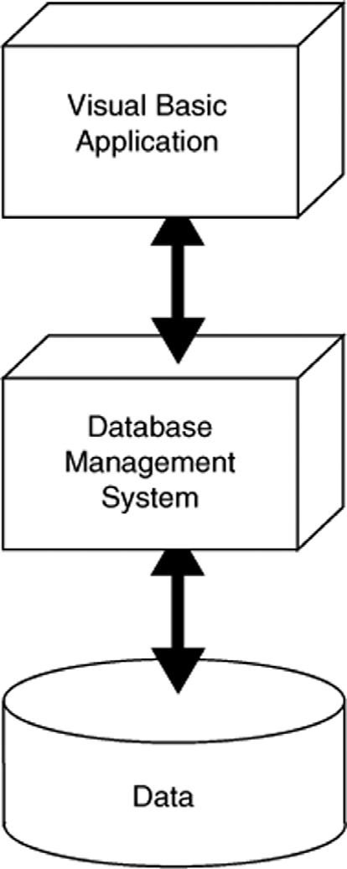
Layered Approach to Using a DBMS
Applications that work with a DBMS use a layered approach
  VB application is topmost layer
  VB sends instructions to next layer, the DBMS
  DBMS works directly with data
Programmer need not understand the physical structure of the data
  Just need to know how to interact with the database

Slide 7
Visual Basic Supports Many DBMS’s
Visual Basic can interact with many DBMS’s
  Microsoft SQL Server
  Oracle
  DB2
  MySQL
Microsoft SQL Server Express used in this chapter, which is installed with Visual Basic

Slide 8
Database Concepts
Section 10.2
A database is a collection of one or more tables, each containing
data related to a particular topic.

Slide 9
Terminology
A Database is a collection of interrelated tables
A Table is a logical grouping of related data
  People, places, or things
  For example, employees or departments
  Organized into rows and columns
A Field is an individual piece of data pertaining to an item, an employee name for instance
A Record is the complete data about a single item such as all information about an employee
  A record is a row of a table
A database schema is the design of tables, columns, and relationships between tables in a database

Slide 10
Database Table
Each table has a primary key or composite key
  Uniquely identifies that row of the table
  Emp_Id is the primary key in this example
Columns are also called fields or attributes
Each column has a particular data type
Emp_Id | First_Name | Last_Name | Department
001234 | Ignacio | Fleta | Accounting
002000 | Christian | Martin | Computer Support
002122 | Orville | Gibson | Human Resources
003400 | Ben | Smith | Accounting
003780 | Allison | Chong | Computer Support
Row
(Record)
Column
Field

Slide 11
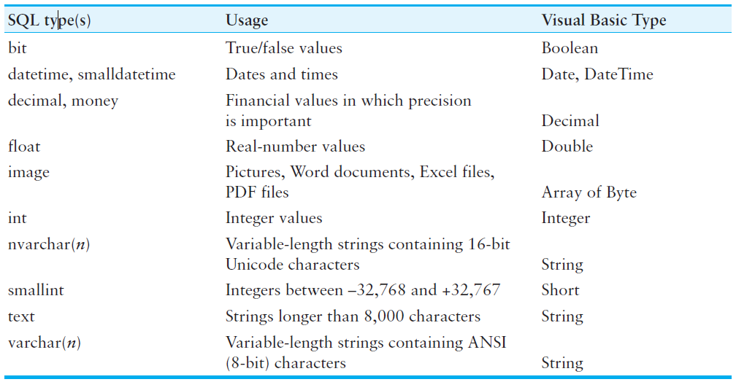
SQL Server Column Types

Slide 12
Choosing Column Names
Define a column for each piece of data
Allow plenty of space for text fields
Avoid using spaces in column names
For the members of an organization:
  Column Name Type Remarks
  Member_ID int Primary key
  First_Name varchar(40)
  Last_Name varchar(40)
  Phone varchar(30)
  Email varchar(50)
  Date_Joined smalldatetime Date only, no time values
  Meeings_Attended smallint
  Officer Yes/No True/False values

Slide 13
Avoiding Redundancy by Using Linked Tables
Create a department table
Dept_ID Dept_Name Num_Employees
1 Human Resources 10
2 Accounting 5
3 Computer Support 30
4 Research & Development 15
Reference department table in employee table
ID First_Name Last_Name Dept_ID
001234 Ignacio Fleta 2
002000 Christian Martin 3
002122 Orville Gibson 1
003000 Jose Ramirez 4
003400 Ben Smith 2
003780 Allison Chong 3

Slide 14
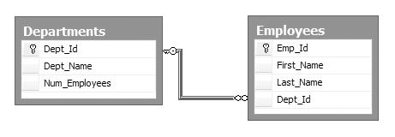
One-to-Many Relationship
Databases are designed around a relational model
A relation is a link or relationship that relies on a common field
The previous changes created a one-to-many relationship
  Every employee has one and only one dept
  Every department has many employees
  DeptID in Departments table is a primary key
  DeptID in Employees table is a foreign key
One-to-many relationship
exists when primary key
of one table is specified
as a field of another table

Slide 15
DataGridView Control
Section 10.3
The DataGridView control allows you to display a database table
in a grid. The grid can be used at runtime to sort and edit the contents
of a table.

Slide 16
Connecting to a Database
Visual Basic uses a technique called Data binding to link tables to controls on forms
  Special controls called components establish the link
  A software tool named a wizard guides you through the process
We will use these data-related components:
  A Data source is usually a database
    Can include text files, Excel spreadsheets, XML data, and Web services
  A Binding source connects data bound controls to a dataset
  A Table adapter pulls data from the database and passes it to your program
    Uses Structured Query Language (SQL) is used to select data, add new rows, delete rows, and modify existing rows
  A Dataset is an in-memory copy of data pulled from database tables

Slide 17
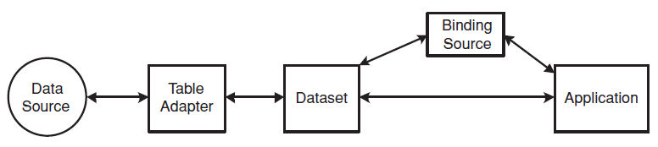
Connecting to a Database
The flow of data from database to application
  Data travels from data source to application
  Application can view/change dataset contents
  Changes to dataset can be written back to the data source
Tutorial 10-1 demonstrates how to connect a database table to a DataGridView control
Tutorial 10-2 demonstrates updating and sorting a table

Slide 18
Data-Bound Controls
Section 10.4
Some controls can be bound to a dataset. A data-bound control
can be used to display and edit the contents of a particular row
and column.

Slide 19
Advantages of Data-Bound Controls
Can bind fields in a data source to controls:
  Text boxes
  Labels
  List boxes
Contents of data-bound controls change automatically when moving from row to row
Data-bound controls also allow the contents of a database field to be changed

Slide 20
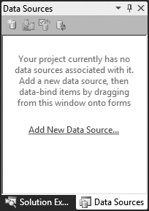
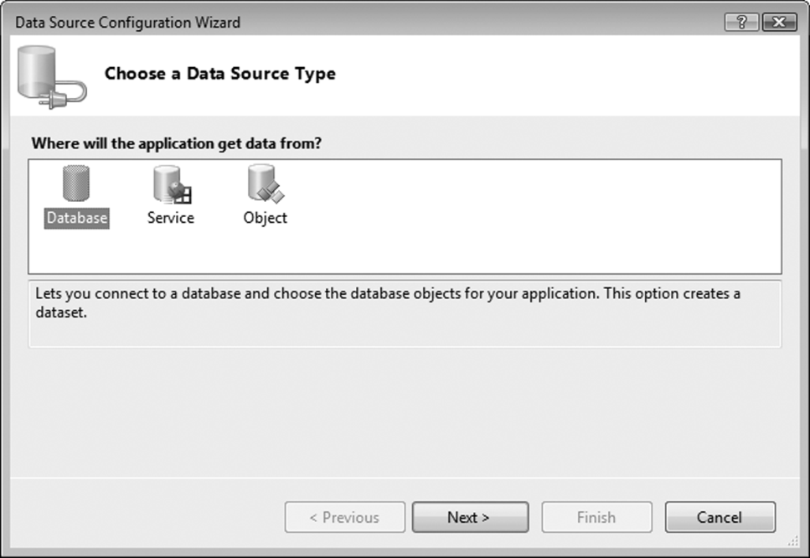
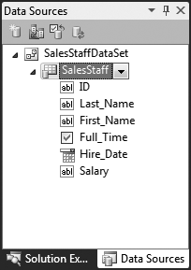
Adding a New Data Source
Open the Data Sources window and click the Add New Data Source link
Follow the steps in the Data Source Configuration Wizard to create a connection to the database

Slide 21
Deleting a Data Source
Once created, it’s almost impossible to rename a data source
Easier to delete and create a new data source than rename one
A data source named Employees for example would be defined by a file named Employees.xsd
To delete this data source:
  Select Employees.xsd file in Solution Explorer
  Press Delete on the keyboard

Slide 22
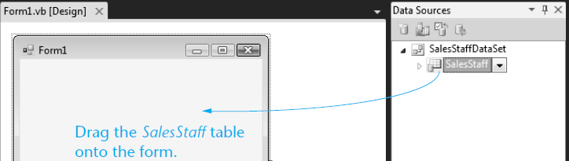
Binding the Data Source to a DataGridView Control
Drag and drop an existing dataset from the Data Sources window to an open area on the form
  For example:

Slide 23

Binding the Data Source to a DataGridView Control
At the same time Visual Studio builds a DataGridView on the form, it adds a number of important objects to the form’s component tray:
  The BindingNavigator creates a ToolStrip at the top of the form
  The DataSet is an in-memory copy of the table
  The BindingSource connects the DataGridView to the DataSet
  The TableAdapter pulls data from the database into the DataSet
  The AdapterManager is a tool for saving data in related tables

Slide 24
Binding Individual Fields to Controls
Use the dataset in the Data Sources window
  Select Details from the table drop-down list
  Drag table to an open area of a form
  Creates a separate control for each field
  Can also drag columns individually
Text and numeric fields added as text boxes
Yes/No fields added as checkboxes
DateTime fields use DateTimePicker controls
May wish to change some control properties
Tutorials 10-3 and 10-4 demonstrate binding

Slide 25
Binding to ListBox and ComboBox Controls
List and combo boxes are frequently used to supply a list of items for a user to select from
Such lists are often populated from a table
Must set two list/combo box properties
  The DataSource property identifies a table within a dataset
  The DisplayMember property identifies the table column to be displayed in the list/combo box
If table column dragged onto a list/combo box
  Visual Studio creates the required dataset, table adapter, and binding source components
Tutorial 10-5 demonstrates binding to a list box

Slide 26
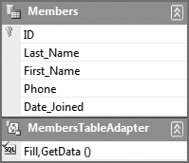
Adding Rows to a Database Table
A TableAdapter provides an easy way to add a row to a database table
To find the TableAdapter you must open a data set’s Schema Definition
A schema definition file (.xsd) was automatically created in Tutorial 10-5 for the Members table Dataset
  Displays the names and data types of fields in the table
To edit the schema definition file:
  Double-click its name in the Solution Explorer window
  An editor window will open
A TableAdapter object was automatically created for the Members DataTable
Each DataTable has a TableAdapter associated with it

Slide 27
Adding Rows to a Database Table
A TableAdapter object has an Insert method
  Used to add a new row to the database table
  Each column is an argument of the method
  Just provide the values for each argument
  For example:
MembersTableAdapter.Insert(10, "Hasegawa", "Adrian",
"305-999-8888",#5/15/2010#)

Slide 28
Identity Columns
Some database tables have an identity column
  Assigned a unique number by the database
  Occurs automatically for identity columns
  No need to manually supply a value for this column
Payments table uses an identity column
  Omit ID column value
  Only supply Member_Id, Payment_Date, and Amount
  Tutorial 10-6 shows you how to insert new rows into the Payments table of the Karate database
PaymentsTableAdapter.Insert(5, #5/15/2010#, 50D)

Slide 29
Using Loops with DataTables
A For Each statement can be used to iterate over the rows collection of a table
Usually, it is best to create a strongly typed row that matches the type of rows in the table
For example:
  Total the Amount column of PaymentsDataSet dataset
Tutorial 10-7 shows how to add a total to the Karate student payments application
Dim row As PaymentsDataSet.PaymentsRow
Dim decTotal As Decimal = 0
For Each row In Me.PaymentsDataSet.Payments.Rows
decTotal += row.Amount
Next

Slide 30
Structured Query Language (SQL)
Section 10.5
SQL, which stands for Structured Query Language, is a standard language for working with database management systems.

Slide 31
Introduction
SQL stands for Structured Query Language
  A standard language for working with database management systems
  Standardized by the American National Standards Institute (ANSI)
  The language of choice for interacting with database management systems
Consists of a limited set of keywords
  Keywords construct statements called database queries
  Queries are submitted to the DBMS
  In response to queries, the DBMS carries out operations on its data

Slide 32
SELECT Statement
The SELECT statement retrieves data from a database
  Used to select rows, columns, and tables
  The most basic format for a single table is:
  ColumnList must contain table column names separated by commas
  The following statement selects the ID and Salary columns from the SalesStaff table:
SELECT ColumnList
FROM Table
SELECT ID, Salary
FROM SalesStaff

Slide 33
SQL Statements and Style
There is no required formatting or capitalization of SQL statements
  The following queries are equivalent:
  As a matter of style and readability
  You should try to use consistent capitalization
SELECT ID, Salary FROM SalesStaff
select ID, Salary from SalesStaff
Select id, salary from salesstaff
SeLeCt Id, SaLaRy FrOm SaLeSsTaFf

Slide 34
SELECT Statement
Field names that contain embedded spaces must be surrounded by square brackets
  For example:
The * character in the column list selects all the columns from a table
  For example:
SELECT [Last Name], [First Name]
FROM Employees
SELECT *
FROM SalesStaff

Slide 35
Aliases for Column Names
Column names can be renamed using the AS keyword
  The new column name is called an alias
  For example:
Renaming columns is useful for two reasons:
  You can hide the real column names from users for security purposes
  You can rename database columns to make user friendly column headings in reports
SELECT Last_Name, Hire_Date AS Date_Hired
FROM SalesStaff

Slide 36
Creating Alias Columns from Other Columns
A query can create a new column from other existing columns
  For example:
  When strings occur in queries they must be surrounded by apostrophes
  The + operator concatenates multiple strings into a single string
SELECT Last_Name + ', ' + First_Name AS Full_Name
FROM Members

Slide 37
Calculated Columns
You can create new columns from calculated column values
  For example, the following query:
    Multiplies the values of two columns
      hoursWorked and hourlyRate
    Displays the result as a new column (alias)
      payAmount
SELECT employeeId, hoursWorked * hourlyRate AS payAmount
FROM PayRoll

Slide 38
Setting the Row Order with ORDER BY
SQL Select has an optional ORDER BY clause that affects the order in which rows appear
    ORDER BY Last_Name, First_Name
  Displays rows in order by last name, then first
  Sort in descending order (high to low) using DESC
    ORDER BY Last_Name DESC
ORDER BY clause appears after FROM clause
    SELECT First_Name, Last_Name, Date_Joined
    FROM Members
    ORDER BY Last_Name, First_Name
  Lists all members by last name, then first

Slide 39
Selecting Rows with the WHERE Clause
SQL Select has an optional WHERE clause that can be used to select (or filter) certain rows
    WHERE Last_Name = 'Gomez'
  Displays only rows where last name is Gomez
  Must be a defined column (in table or created)
This example selects based on a created field
  SELECT Last_Name, hrsWorked * Rate AS payAmount
  FROM Payroll
  WHERE payAmount > 1000
  ORDER BY Last_Name
  Selects those being paid more than $1,000

Slide 40
Relational Operators
SQL WHERE clause uses relational operators like an If statement
Operator Meaning
= equal to
<> not equal to
< less than
<= less than or equal to
> greater than
>= greater than or equal to
BETWEEN between two values (inclusive)
LIKE similar to (match using wildcard)
Example of BETWEEN operator:
  WHERE (Hire_Date BETWEEN '1/1/1992' AND '12/31/1999')
Example of LIKE operator with % sign as wildcard:
  WHERE Last_Name LIKE 'A%'

Slide 41
Compound Expressions
SQL uses AND, OR, and NOT to create compound expressions
Select all employees hired after 1/1/1990 and with a salary is greater than $40,000
  WHERE (Hire_Date > '1/1/1990') AND (Salary > 40000)
Select all employees hired after 1/1/1990 or with a salary is greater than $40,000
  WHERE (Hire_Date > '1/1/1990') OR (Salary > 40000)
Select employee names not beginning with A
  WHERE Last_Name NOT Like 'A%'

Slide 42
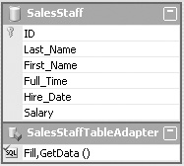
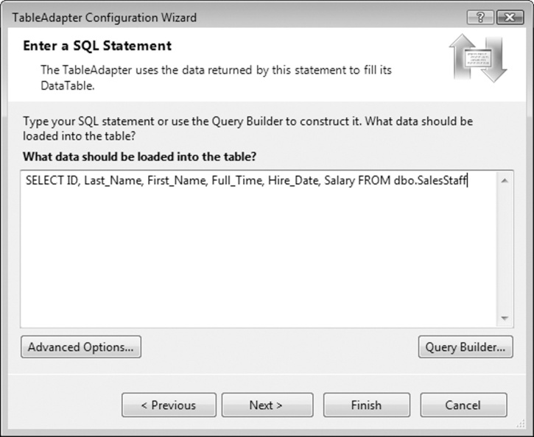
Modifying the Query in a Data Source
Dataset schema file contains an SQL query
  Created as part of schema file
  Named Fill, GetData() by default
Right-click title bar
of TableAdapter in schema
  Click Configure from pop-up
  Use Configuration Wizard
  to change simple queries
  Query Builder often used
  for complex queries

Slide 43
Query Builder
Visual Studio tool to work with SQL queries
Consists of four sections called panes
  The Diagram pane displays tables
  The Grid pane (Criteria pane)displays query in spreadsheet form
  The SQL pane shows actual SQL created
  The Results pane shows data returned by query

Slide 44
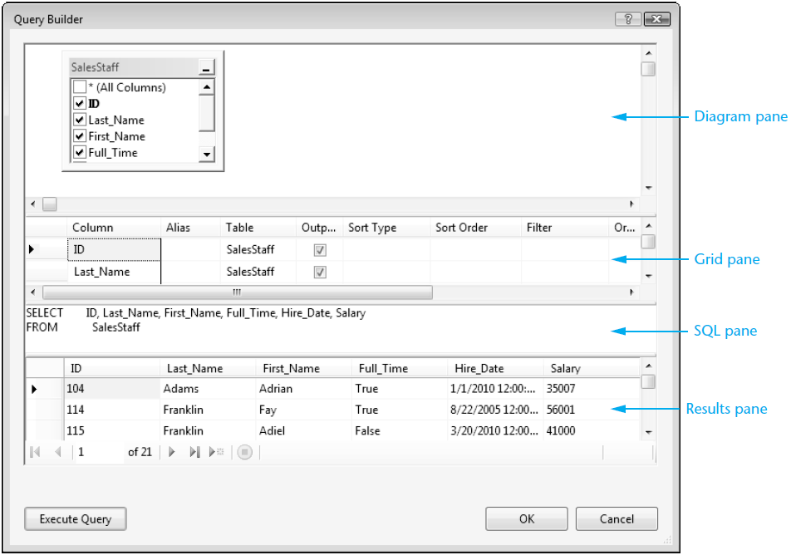
Example Query Builder Window

Slide 45
Adding a Query to a TableAdapter
Can add a new query as well as changing an existing one
  Right-click the TableAdapter icon in component tray
  Select Add Query
  The Search Criteria Builder window appears
Add WHERE clause to the SELECT statement
  Select the New query name to enter a name for query
Query made available from ToolStrip control
Tutorial 10-8 shows how to filter rows in the SalesStaff table

Slide 46
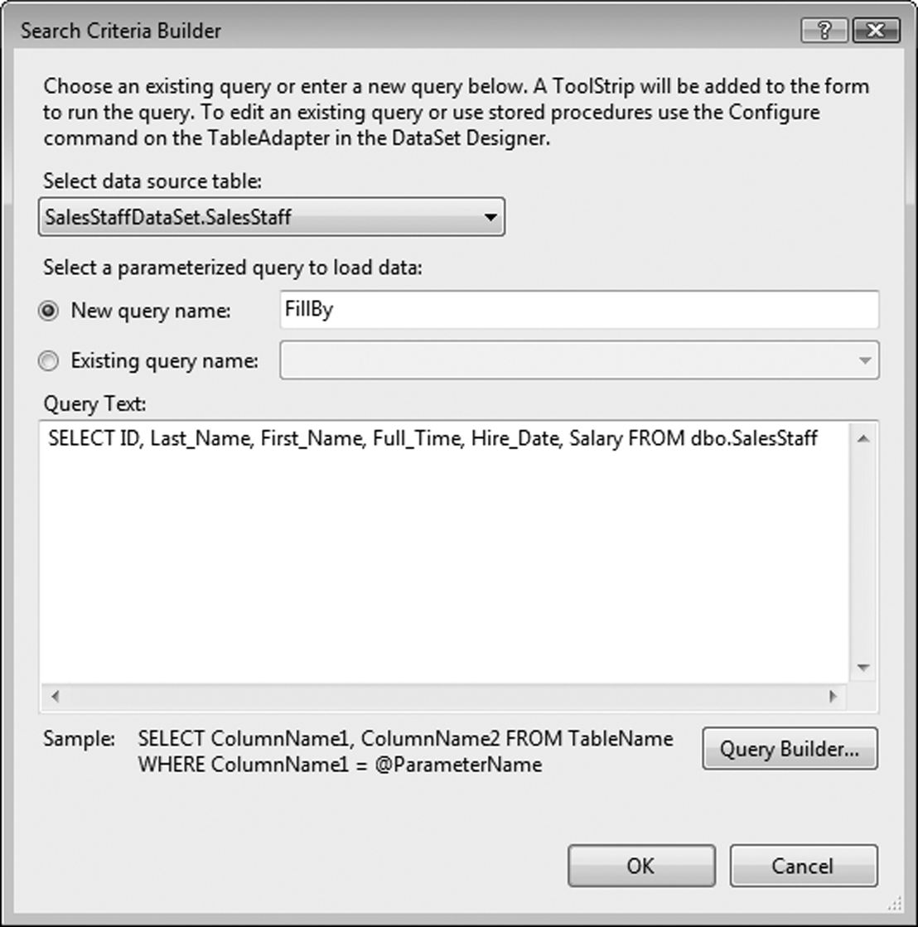
Example Search Criteria Builder Window

Slide 47
Focus on Problem Solving: Karate School Management Application
Section 10.6
Develop the Karate School Management Application

Slide 48
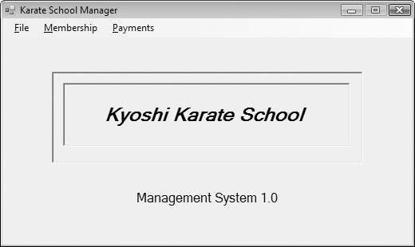
Karate School Manager Startup Form
Menu Selections:
  File
    Exit
  Membership
    List All
    Find member
    Add new member
  Payments
    All members
    One member

Slide 49
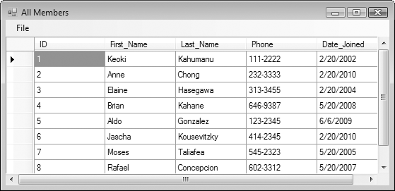
All Members Form

Slide 50
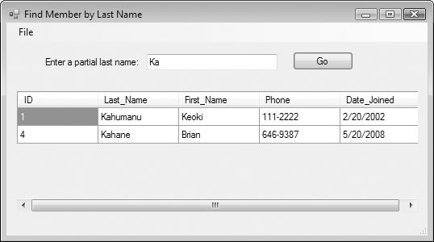
Find Member by Last Name Form

Slide 51
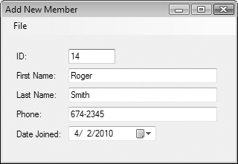
Add New Member Form

Slide 52
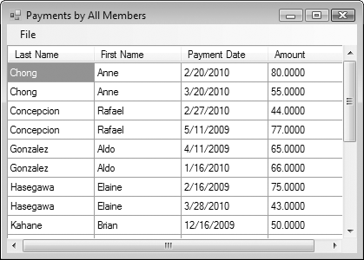
Payment Form

Slide 53
Introduction to LINQ
Section 10.7
LINQ (Language Integrated Query) is a query language that is built
into Visual Basic and can be used to query data from many sources
other than databases.

Slide 54
LINQ
SQL allows you to query the data in a database.
LINQ allows you to query data from many other sources.
LINQ is built into Visual Basic.

Slide 55
Using LINQ to Query an Array
Suppose we have the following array:
The following statement uses LINQ to query the array for all values greater than 100:
Dim intNumbers() As Integer = {4, 104, 2, 102, 1, 101, 3, 103}
From item In intNumbers
Where item > 100
Select item

Slide 56
Using LINQ to Add Query Results to a ListBox
We can add the results to a ListBox
' Create an array of integers.
Dim intNumbers() As Integer = {4, 104, 2, 102, 1, 101, 3, 103}
' Use LINQ to query the array for all numbers
' that are greater than 100.
Dim queryResults = From item In intNumbers
Where item > 100
Select item
' Add the query results to the list box.
For Each intNum As Integer In queryResults
lstResults.Items.Add(intNum)
Next

Slide 57
Sorting the Results of a LINQ Query
Sort in ascending order:
Sort in descending order:
Dim queryResults = From item In intNumbers
Where item > 100
Select item
Order By item
Dim queryResults = From item In intNumbers
Where item > 100
Select item
Order By item Descending

Slide 58
More About LINQ
LINQ uses operators that are similar to SQL
Unlike SQL, LINQ is built into Visual Basic
Queries are written directly into the program
  VB compiler checks the syntax of the query
  Immediately displays LINQ mistakes
LINQ can be used to query any data that is stored in memory as an object
An application named LINQ can be found in the Chap10 student sample programs folder

