Slide 1
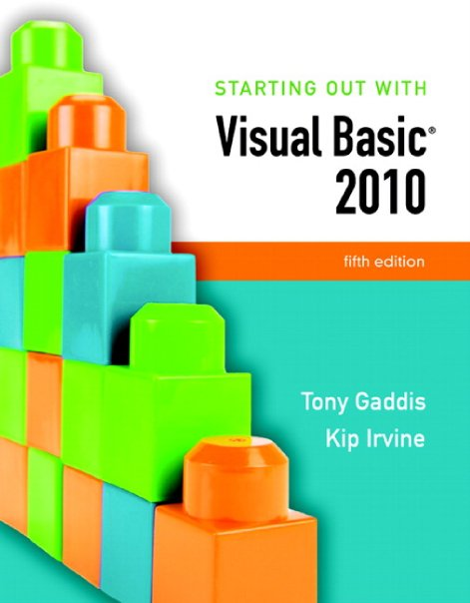

Slide 2
Chapter 11
Developing Web
Applications

Slide 3
Introduction
In this chapter you will learn about:
Programming for the World Wide Web
Creating ASP.NET applications
Web server controls and web forms
Using databases in ASP.NET

Slide 4
Programming for the Web
Section 11.1
A Web application runs on a Web server and presents its content
to the user across a network, in a Web browser.

Slide 5
HyperText Markup Language
HTML stands for HyperText Markup Language
Describes appearance of web pages
A standardized formatting language
It is not a programming language
Formatting instructions appear as commands called tags embedded in the web page text
Text following the bold tag (<b>) is shown in bold until an end bold tag (</b>) appears
<b>This text is bold.</b>This text is normal.
Web design editors create HTML for you

Slide 6
ASP.NET
The acronym ASP originally stood for Active Server Pages
ASP.NET ,the next generation, is a server-side Web programming platform
Provides development tools and visual controls for web browser based applications
Contains Web forms and controls, HTML, and program logic in compiled VB code
VB knowledge transfers directly to ASP.NET
VB code runs on the server, not the client
Server runs code that creates an HTML page
Client web browser receives the HTML

Slide 7
Web Clients and Web Servers
The client-server model
A server is a computer that produces data
A client is a computer that uses the data
Web applications use the client-server model
Web browsers run on clients and request data from web servers
Web sites are hosted on Web servers that produce data as requested by Web browsers

Slide 8
Uniform Resource Locator (URL)
A URL (Uniform Resource Locator)references a particular web page
For example:
http://pearsonhighered.com
Begins with the protocol
http://
Then the domain name
pearsonhighered.com
May end with a specific folder path and/or filename
The URL is used as an address that uniquely identifies the web page to be retrieved

Slide 9
Displaying a Web Page
What happens when a Web page is displayed by a Web browser?
A computer must be running a Web server, which waits for browser connection requests, this occurs in two steps:
Browser connects to server requesting a URL
Server translates URL into a physical file located within the server’s file system and sends the requested file, called a Web page, back to the browser
Server breaks connection after sending Web page
Web Browser interprets HTML and renders a Web page
Postback occurs if client requests Web page again
By clicking a button control or pressing the Enter key

Slide 10
Web Forms
ASP.NET web pages are called Web forms
A web form
Uses a file name extension of .aspx
Contains text, HTML tags, and HTML controls
Also contains Web server controls such as text boxes, list boxes, and buttons
Also known as ASP.NET Server controls
Similar to Windows Forms controls
The Program logic for a Web form
is stored in a related code-behind file with extension aspx.vb
A Cascading style sheet (CSS) file customizes the appearance of a Web form

Slide 11
Web Servers
Web applications must be run using a Web server
Three choices are available:
The ASP.NET Development Server
Installed automatically with Visual Studio
Internet Information Services (ISS)
An option with certain versions of Microsoft Windows
Requires careful security configuration
A remote Web server
Typically available through an Internet Service Provider (ISP)or a corporate Web server
Must always have an account with a username and password

Slide 12
HTML Designer and Web Browser Support
HTML Designer is a tool in Visual Studio that simplifies the design of Web pages and Web forms
Generates HTML source code and ASP.NET Web controls
Offers the following views of a Web page:
A Design view similar to Visual Studio’s forms editor
A Source view for direct editing of HTML source code
A Split view that displays both views in separate panels
There are many different Web browser versions in use
ASP.NET detects and generates version specific HTML
Always test Web applications on other browsers
Chrome, Safari , and Firefox are good choices

Slide 13
Types of Controls
Group | Description
Standard | Commonly used controls on Web forms
Data | Controls for connecting to and displaying data
Validation | Controls for validating user input
Navigation | Advanced controls for navigating between Web pages
Login | Controls related to authentication of usernames and passwords
WebParts | Controls modify content, appearance, and behavior of Web pages
AJAX Extensions | Controls that provide rich interface experiences
Reporting | Contains Microsoft Report Viewer for displaying Web-based reports
HTML | Standard HTML controls that do not generate user events

Slide 14
Creating ASP.NET Applications
Section 11.2
You can use Visual Studio or Visual Web Developer Express Edition
to create Web applications in Visual Basic.

Slide 15
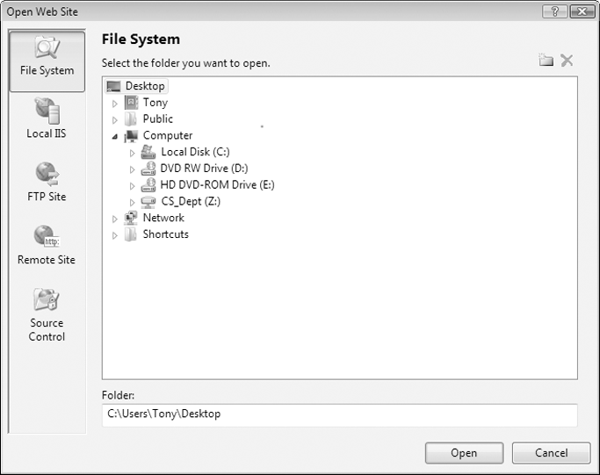
Open Web Site Dialog Box
Select Open Web Site from the File menu when you want to open an existing Web application

Slide 16
Types of Web Sites
A File System Web Site is best suited to a network
Uses ASP.NET Development Server
Supplied with Visual Studio
Simple to use, not open to security attacks
Local ISS for a local Web server
Uses Internet Information Services, or IIS
Professional level, extensive security features
Extensive set-up, must have admin rights
FTP Site is located on a different machine
Stands for File Transfer Protocol
Usually on the Internet
Provides a way of copying files from one machine to another
Remote Site if existing site on remote server
Need userID & password to upload application

Slide 17
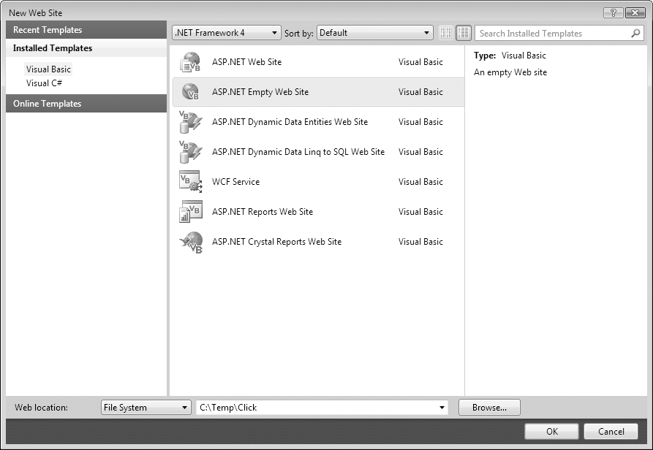
Creating a Web Application
Click New Web Site from File menu
The New Web Site dialog box appears

Slide 18
Creating a Web Application
The New Web Site dialog box lists possible Web sites templates
Select ASP.NET Empty Web Site from the list
Choose a folder for the project
If File System, can choose to use any folder on local computer or network
If HTTP, application will be located on a Web site set up by IIS
If FTP, must use Web site on remote computer
When created, an empty Web site contains only one file named Web.config

Slide 19
Opening an Existing Web Application
To open an existing Web application
Select project from Recent Projects window
If project doesn’t appear in Recent Projects click
Open: Web Site… link in Recent Projects
Or click Open Web Site on File menu
Either of the two previous options display an Open Web Site dialog box
Navigate to folder containing Web site
Click Open

Slide 20
Running a Web Application Project
Can change default browser for your project
Right-click project name in Solution Explorer
Select Browse With... from shortcut menu
To run your Web application
Click Run Without Debugging on Debug menu
Web forms allow constants called static text
No label control required like a Windows form

Slide 21
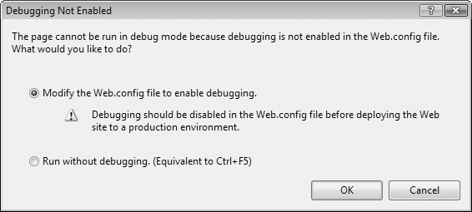
Running a Web Application Project
Must configure a project for debug capability
Message box shown when first running a project in debug mode
Clicking OK adds option to Web.config file that enables debugging
Tutorial 11-1, you create the Click application

Slide 22
Web Server Controls
Section 11.3
Web Server controls are similar to controls used in Windows
applications. You use Web Server controls to make ASP.NET
Web applications interactive.

Slide 23
Web Server Controls Overview
Make ASP.NET dynamic and interactive
Work like HTML controls but far more flexible
Class based with properties, methods, events
Similar to Windows form controls, making it easy for VB programmers to learn
Frequently used Web controls:
Button ImageButton LinkButton
Label RadioButton RadioButtonList*
TextBox CheckBoxList* ListBox
CheckBox Image Calendar
DropDownList
* Those noted with asterisk have no Windows form equivalent

Slide 24
Web Server Controls Overview
Web controls properties similar to those of Windows form controls including
Text, Enabled, Visible, Font, ReadOnly, and so on.
There are some important differences
Windows control Name property same as the ID property for Web controls
Web controls have an AutoPostBack property
Web controls lose runtime properties when the user moves away from that page
Must save state to retain runtime properties

Slide 25
How Web Controls Are Processed
ASP.NET functions differently from HTML
The Web server executes the VB code found behind the ASP.NET Web page
When a browser requests an .aspx Web page
Server reads/interprets Web controls on page
VB statements in code-behind file executed
Web page of standard HTML tags and controls built using .aspx Web controls and VB code
HTML Web page sent back to browser

Slide 26
Label and Text Controls
Label control displays data from program
Use only if label text will change at runtime
If text does not change, set up as static text
TextBox control holds text input by user
TextMode property can be:
SingleLine: permits a single line of input
MultiLine: permits multiple lines of input
Password: characters typed appear as asterisks
Deal with browser compatibility issues using:
Columns property to control TextBox width
Rows property to specify entry of multiple lines

Slide 27
CheckBox Control
Functions almost identically to CheckBox in Windows forms
Text property sets text visible to user
Evaluate Checked property at runtime to determine if control checked by user
TextAlign lets you position text
Tutorial 11-2 creates a Web sign-up for a Student Picnic application

Slide 28
Handling Events in Web Forms
Events fire differently in Web forms
Page_Load event fires each time a page is displayed instead of just the first time
Page_Load fires before other events such as TextChanged
Mouse click on a control with AutoPostBack property set to true sends form back to server
Useful if server should react to a mouse click such as selecting an item from a list box
Occurs automatically for Button, LinkButton, and ImageButton controls

Slide 29
HyperLink Control
Provides a link to navigate to another page
Text property specifies text shown for link
NavigateURL property holds destination URL
Target property determines if a new browser window is opened to display the new page
Set equal to _blank to open a separate window

Slide 30
ImageButton, LinkButton, and RadioButtonList
ImageButton provides a clickable image
Generates a click event
ImageURL property specifies path to image
LinkButton behaves like a hyperlink but generates a click event
RadioButtonList is a group of radio buttons
Functions similar to a ListBox
Has SelectedIndex & SelectedValue properties

Slide 31
ListBox Control
Very similar to the Windows ListBox control
Has an Items collection
Has the ListBox properties SelectedIndex, SelectedItem, and SelectedValue
SelectionMode property specifies whether multiple list items may be selected
SelectedIndexChanged event handling
Must set AutoPostBack to true if this event should fire immediately upon a user selection
If not, event fires only after another control causes form to be posted back to the server

Slide 32
CheckBoxList and DropDownList
CheckBoxList control looks like group of check boxes but works like a ListBox
Has an Items collection
Has the ListBox properties SelectedIndex, SelectedItem, and SelectedValue
Each item has a Boolean Selected property
DropDownList similar to ComboBox except:
Initial value of SelectedIndex always zero so the first item is always displayed
Must select item from list, cannot key entry

Slide 33
Designing Web Forms
Section 11.4
HTML tables can be used to design a Web application’s user interface.
HTML tables provide a convenient way to align the elements
of a Web form.

Slide 34
Using Tables to Align Text and Controls
Essential tool in Web form design
Creates a grid of rows and columns
Text and controls placed inside cells of the grid
Permits text and controls to be aligned
Align by right or left justifying each column
Blank columns may be used for spacing
Click Insert Table in Table menu to show Insert Table dialog box

Slide 35
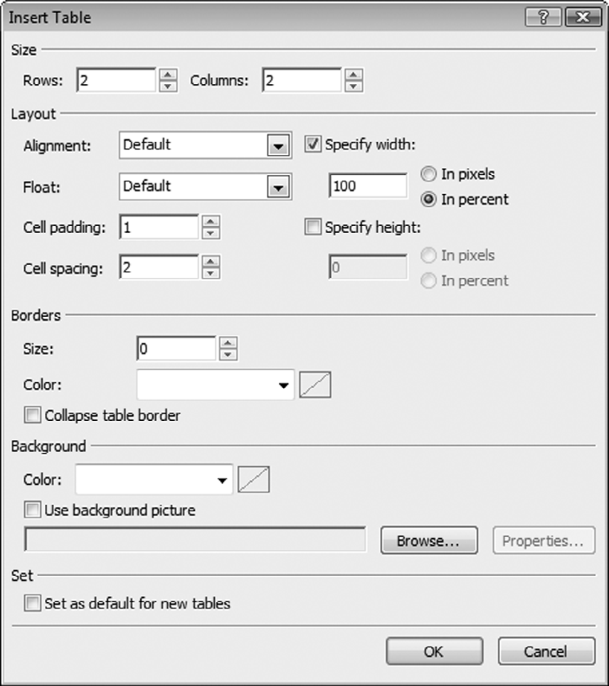
Insert Table Dialog Box Example

Slide 36
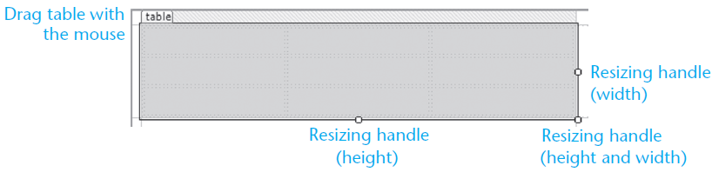
Adjusting Row Heights and Column Widths
Click and drag to adjust row height or column width
Insert rows or columns with Insert on Table menu
Can set cell Align property to center, left, or right
Adjacent cells can be merged together
Drag mouse over cells to be merged
Select Merge Cells from Layout menu
Tutorial 11-3 aligns controls with HTML table

Slide 37
Applications with Multiple Web Pages
Section 11.5
A Web application may use multiple Web pages to display data and
interact with the user.

Slide 38
Adding New Web Forms to a Project
Two ways to add a new Web form to a project
Select Add New Item from Web Site menu
Right-click project in Solution Explorer and select Add New Item
Either displays the Add New Item window
Select Web Form icon
Enter name of page
Be sure Place code in separate file checked

Slide 39
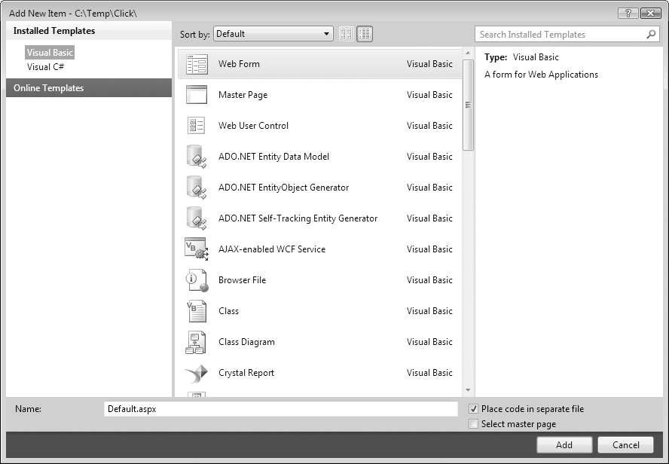
Adding a Web Form to a Project

Slide 40
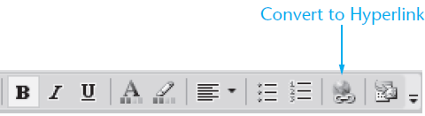
Moving Between Pages
To allow the user to move between pages:
Specify URL of target page in NavigateURL property of a HyperLink control
Use Response.Redirect method in click event of a Button, ImageButton, or LinkButton
Use HyperLink button on Formatting toolbar to convert static text into a hyperlink

Slide 41
Calling Response.Redirect
Allows programmer to display another Web page using code in a click event handler
Transfer to Web page Page_two.aspx using:
Response.Redirect("Page_two.aspx")
Complete URL needed to display a page on another server:
Response.Redirect("http://microsoft.com")
Tutorial 11-4 adds a description form to the Kayak Tour application

Slide 42
Using Databases
Section 11.6
ASP.NET provides several Web controls for displaying and
updating a database from a Web application.

Slide 43
Web Forms Database Access
Web forms database access differs from that used for Windows forms
Dataset not used
DataSource control used instead
Access databases use AccessDataSource control
SQL Server databases use SqlDataSource control
DataSource controls update database directly
No Update method required as with a dataset

Slide 44
GridView Database Connection Setup
Data Source option in GridView Tasks menu allows database connection to be configured
Copy database file to App_Data folder
Select Data Source, use Database
Select database file from the App_Data folder
Configure Select statement for the SQL query
If query requires multiple tables, must create custom SQL using Query Builder
Places a DataSource control on the Web form
Tutorial 11-5 configures a GridView control

Slide 45
Using a DetailView Control to Modify Table Rows
Found in Data section of Toolbox window
GridView only displays database tables
DetailsView can be used to view, edit, delete, or add rows to a database table
Connect to data source just as with GridView
Allows you to create an effective update program without writing any code
Tutorial 11-6 demonstrates how to use the DetailsView control

Slide 46
SQL Queries Inside the SqlDataSource Control
To see how a SqlDataSource is represented in HTML code
Click the Source tab for the Default.aspx page and look for the sqlDataSourceControl
The following code shows the beginning of the code that defines the MembersDataSource from Tutorial 11-6:
A connection string definition:
The DeleteCommand property:
The InsertCommand property:
<asp:SqlDataSource ID="MembersDataSource" runat="server"
ConnectionString="<%$ ConnectionStrings:karateConnectionString %>"
DeleteCommand="DELETE FROM [Members] WHERE [ID] = @ID"
InsertCommand="INSERT INTO [Members] ([ID], [Last_Name],
[First_Name], [Phone], [Date_Joined]) VALUES (@ID, @Last_Name,
@First_Name, @Phone, @Date_Joined)"

